Slide 1
Be CRAFFTy
Ramkumar Jayagopalan, M.D

Slide 2
Why Screen ?
Substance abuse is the number one health problem in US
Half of high school student drink, one third binge drink, and one fourth smoke marijuana.
Substance abuse has been linked to both mental and physical problems.
Primary care offices are ideal places for screening.
Less than one half of physicians report screening all adolescent patients for substance use, and less than one fourth report screening for drinking and driving.

Slide 3
Barriers for screening
Belief that the prevalence of the problem is low.
Inadequate training.
Lack of time or personnel.
Lack of effective treatments.
Lack familiarity with simple screening methods.

Slide 4
Why CRAFFT ?
Easy to administer, developed specifically for adolescents
Simple to score
Valid screening test
Screens for other drugs as well as alcohol
Can be orally administered

Slide 5
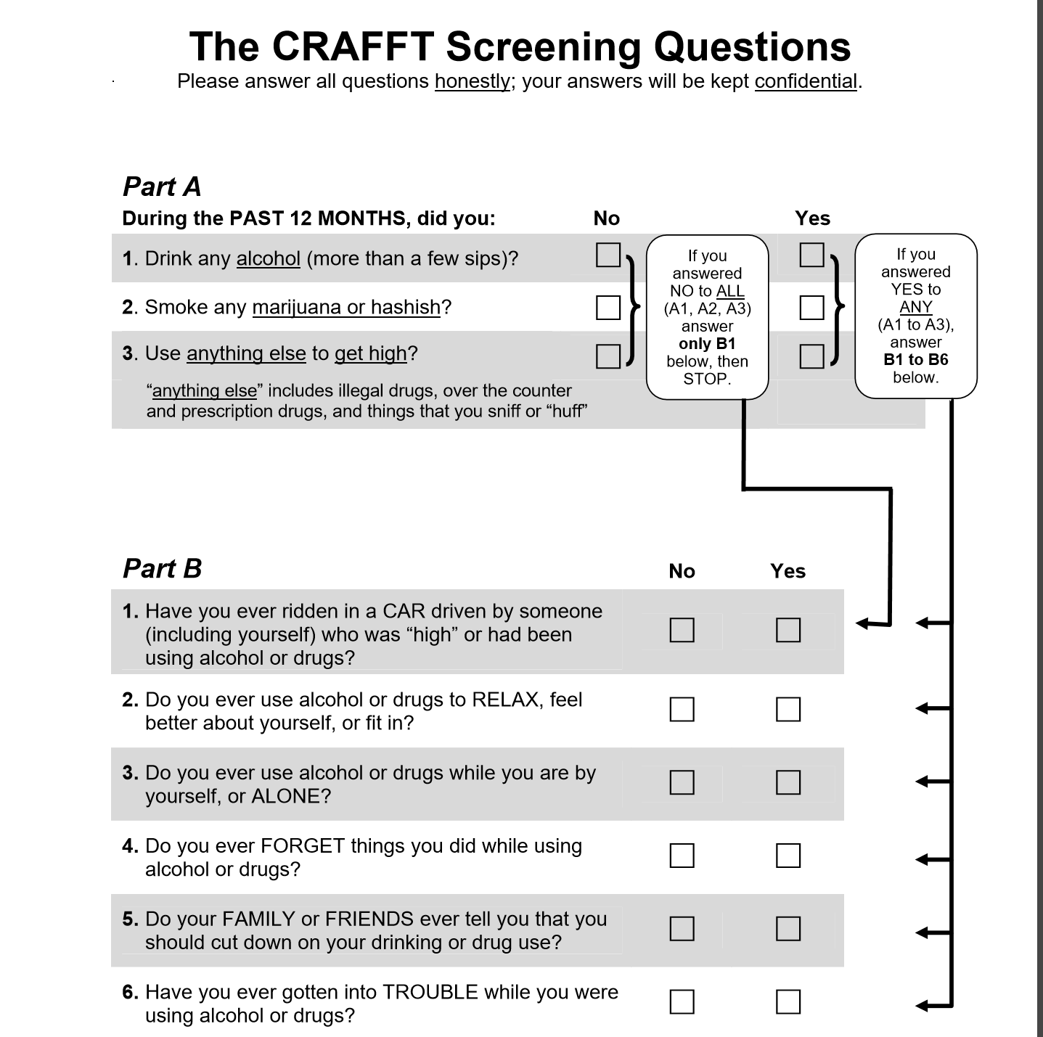

Slide 6
Scoring
Any “Yes” is 1 score.
Score of 2 or more is significant for drug addiction and dependence.
Higher the score, greater the risk of addiction.

Slide 7
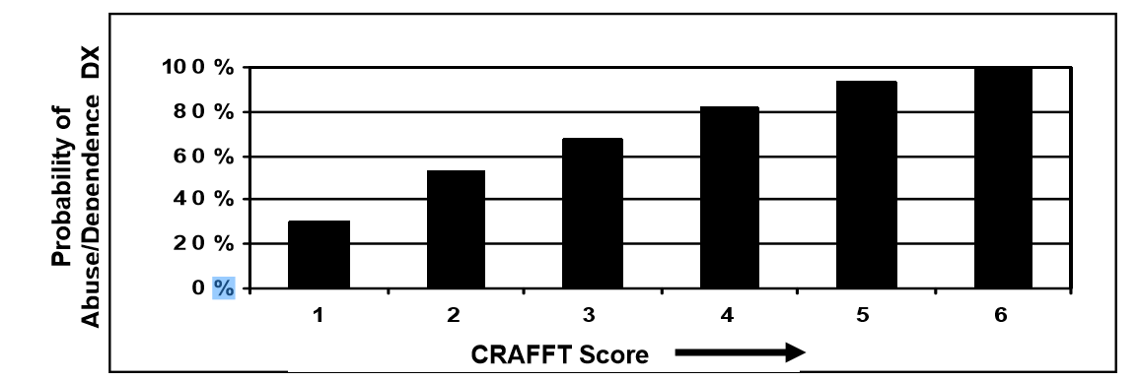

Slide 8
Talking points
No Use
Not using drugs and alcohol is a smart decision for your health. You should be proud of yourself. If that ever changes, I hope you trust me enough that we can talk about it.
Any Use
My recommendation as your doctor is not to use drugs or alcohol at all.
Referral for scores of 4 or above

Slide 9
Coding
“ 96127”
Average 7$ payment.

Slide 10


