Slide 1
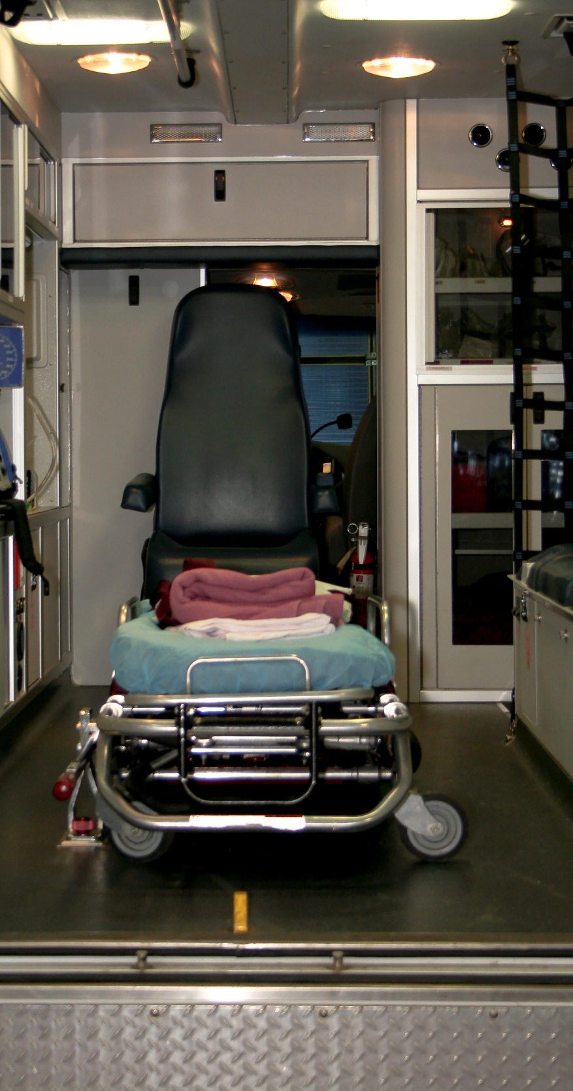
2012 Medicaid Transportation Provider Survey Results December 2012
Kathy Mayfield Smith, MA, MBA
Ana Lòpez – De Fede, PhD
USC Institute for Families in Society
Division of Policy and Research on Medicaid and Medicare

Slide 2
Background

Slide 3
Objective
Conduct a survey of SCDHHS Non-Emergency Medical Transportation (NEMT) Providers to:
Assess state of NEMT provider network
Assess provider experience and satisfaction
Gather input and recommendations for improvement

Slide 4
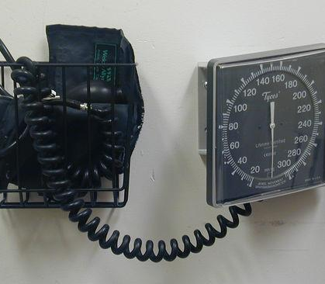
Methodology

Slide 5
Survey and Data Collection
21 Question survey
Combination standard response and open-ended questions
Population of 151 NEMT providers
Mixed method data collection:
Mailed letter and survey
Telephone follow-up
1-800# for call backs/questions

Slide 6
Demographics

Slide 7
Demographics - Provider
95 providers completed surveys for a 63% return rate (95/151)
58% (88) continue to provide NEMT
5% (7) no longer provide NEMT
Service areas range from single county to entire state
Provider types
For-profits (70%)
Non-profits (24%)
Regional Transit Authority-RTA (2%)
Time providing NEMT
Most (64%) have provided NEMT for between 1-5 yrs.
Average number of years providing transportation is 8
Range is 3 months – 40 years
Some (6%) have provided for less than 1 year

Slide 8
Demographics - Fleet
Providers utilize a variety of vehicles
Most common vehicles are accessible/ambulatory vans
Average age of vehicles is about 6.5 years (<1 – 16 yrs.)
Vehicle Type | # providers with vehicles for Medicaid | Total # of vehicles | Approx. # vehicles for Medicaid NEMT | Range of # of vehicles | Average Age of vehicles | Range of age of vehicles
Sedan, ambulatory | 30 | 127 | 113 | 1 - 10 | 6.6 | <1 – 16 years
Van/bus, ambulatory | 48 | 361 | 315 | 1 - 35 | 6.2 | <1 – 15 years
Van/bus, wheelchair accessible | 46 | 474 | 463 | 1 - 80 | 6.3 | 1 – 15 years
Ambulance | 25 | 385 | 261 | 1 - 85 | 6.8 | 3 – 15 years

Slide 9
Demographics - Fleet
Ability to replace vehicles in fleet
A majority (72%) are able to replace their vehicles
For-profit (79%) and RTA (100%) providers are more comfortable in their ability to replace vehicles than non-profit (48%) providers
8% have of all major concerns about ability to maintain safety and reliability
Criteria used to replace/cycle vehicles
Most (90%) providers use general condition of the vehicle
Approximately half (54%) use mileage and age (51%) of vehicle

Slide 10
Demographics - Trips
Most (69%) providers would prefer to make more trips [For-profits and RTAs (75%); Non-profits (52%)]
28% have about the right amount; only 2% want less
Change in number of trips since February 2012
31% have increased
44% have decreased
Number of Trip Made per day | Average | Range
Weekdays | 69 | 0 - 197
Saturday | 19 | 0 - 197
Sunday | 2 | 0 - 60

Slide 11
Results

Slide 12
Experience and Satisfaction
With your business/organization
Most providers (67%) expect business to expand in next 5 years
Feelings about quality of participation in Medicaid NEMT varies with 37% indicating it has remained stable; 33% indicating it has declined and 29% indicating it has improved
Single biggest threat to business: low reimbursements and higher operating costs (22), lack of trips (15)
With Current broker
Less than half (39%) believe services for consumers have improved
Most common problems include: lack of consumer choice of provider (11), poor communication (7), lower availability of providers (7), missed appointments (5), long waits to be picked up, don’t schedule trips with less than 3 days notice even if resources available, scheduling problems such as mix-ups and no standing orders (5), and technology problems (use of faxes, phone system complicated for seniors)
Most common improvements include: On-time performance (7), level of accountability of providers better (4), higher safety standards (3), educating consumers on policy and procedures (2), allows scheduling appointments in advance, more organized (2)

Slide 13
Experience and Satisfaction Current broker continued
Almost two-thirds (62%) believe services have not improved for providers
Most Common Positives | Most Common Problems
Work with provider to deliver quality service (8); e.g., monitoring - broker visits sites and grades providers, more driver training Get paid on time (3) Electronic billing and web portal (2) Ability to get answers quickly (2) Increased business (2) | Lower rates (16), but higher expectations (6) and increased costs, i.e., insurance and gas (8) Reduced or poor communication (9), e.g., slow to return calls, difficult to get management on phone, back & forth confusion Unprofessional staff (5)- faxed information lost or not entered correctly, wrong phone # or address of consumer, rude Poor technology (4)- e.g., fax trip schedules rather than online Less cost effective (7)- don’t coordinate rides so provider can transport more than one person to same location, require previously local providers to go outside service area – up to 80 miles for pick-up, out-of-county providers transport to my area when I am available), don’t pay for “deadhead” miles No consumer choice (3) – e.g., previously regular consumers who request my company no longer get assigned Assignment inequities (3)– appear to assign more trips to “favorite providers,” blame computer glitches Paid less frequently

Slide 14
Recommendations Changes to System to allow provider success
Adequate reimbursement
DHHS should set a standard minimum rate taking into consideration avg. cost of running a vehicle per day; make broker pay fuel reimbursements as promised
Improve broker IT/other systems
Require better IT system
Improve communication between broker and provider/facilities
More 2-way communication to promotes systematic approach for allocating work flow and volume
Scheduling and efficiencies of scale
More flexibility to multi-load, assign multiple trips from same area going in same direction
Better system to schedule and route trips to have volume and make trips more comfortable
Allow providers flexibility in scheduling
Person responsible for scheduling trips should be educated on trip areas and needs of consumers (e.g., high medical need with appropriate provider)
Better communication and wider window of times available for provider to call
Better responsiveness to calls/questions
Monitor fax machine;
Provide user-friendly website allowing providers to accept/reject trips (to build own manifest)
Better billing system; be able to electronically access pick-up times that broker puts in system
Minimize distance traveled out of local area; pay all providers same rate for same level of service
Increase trips; consider costs of operation adjustments (e.g., gas)
Pay for A leg when consumer is “no show” especially on longer distance trip
Have a contract with facilities so they know who to call, etc.

Slide 15
Recommendations Swapping Role with Broker (120 responses)
Improve Operational Efficiency (N = 45)
Scheduling/Coordination of trips (#1 recommendation) - coordinate by zip code, facility and distance to allow multi-loading, book local trips with local providers first, allow 30 day advance scheduling and provider to see; allow scheduling within 3 days if providers can do; get rid of or be flexible with pick-up times
Administrative - minimize paperwork, more assistance in learning procedures, easier process to get drivers/EMTs approved, consolidate inspections (1 company’s busses inspected by 3 agencies last spring); create better billing system, reduce paperwork, problems with fax machine
Improve/better use of technology – use better technology for scheduling; system to allow providers to select trips 30 days in advance; interactive website so providers can posts trips and pickup trips others cannot service; and re-implement system that allows exchange between providers and transporters
Education of staff – train on service area (maps/locations in relation to provider and facility), customers’ needs; provider capacity/ability; have a route manager trained in efficient route management; train on good customer service (e.g., phone etiquette, rudeness)

Slide 16
Recommendations Swapping Role with Broker (120 responses)
Improve Reimbursements/rate (N = 25)
Timeliness – pay providers weekly
Competitive rates/cost of operations adjustments –cost of “decent” drivers, increased fuel, insurance
Rate equity across providers – “favoritism;” distribute trips fairly; equal pay for same trips
Pay for “no shows” and “deadhead miles” – trips are longer, less multi-loading of riders
Provide loans/incentives to providers who perform well to help develop
Improve relations/communication with providers (N = 23)
Build better relationship with providers – consider providers as partners, not “work horses”
Designate a service representative for providers – increase availability, responsiveness
Timely notice of procedural changes – communicate between quarterly meetings
Meet with providers to get input, discuss their needs and know them and their capabilities
Improve customer service
Have independent organization address complaints between providers and broker
Customer care (N = 21)
Allow consumer choice of providers
Hold consumer accountable for “no shows”
Verify phone and address of consumer

Slide 17
Recommendations Swapping Role with SCDHHS (N = 79)
Changes to Brokerage System
Eliminate broker and return to DHHS
Set standards for broker (e.g., timely notification to providers, equal pay for same service, timely reimbursement of providers, extended hours for provider assistance after hours)
Monitor broker and hold accountable
Ensure all transportation is under broker system including Councils on Aging
Hire more field agents to monitor transportation providers behavior and compliance
Allow DHEC EMS to oversee ambulances
Revisit report cards – a lot of the information does not reflect provider work
Permit background check conducted by other state agencies (e.g., DSS child care, foster parents) to be used for transportation
Communication with providers
Get input from providers – survey is good start, meet with providers (without broker) regularly
Facilitate meeting of broker and providers to collectively find ways to improve efficiency/quality

Slide 18
Recommendations Swapping Role with SCDHHS (N = 79)
Reimbursement rates
Develop pay for performance incentives with input from providers to support improved quality
Set minimum rate that supports safe operations – Assist providers to negotiate COL adjustments
Permit multiple transporters a day for transportation (e.g., parent transports to treatment; facility transports home)
Consumer Care
Get consumer input and opinions to gather more than just complaints
Provide a hotline to make transportation more accessible
Provide a ride reservation and “Where’s My Ride?” number that remains the same when brokers change to avoid confusion for consumer

Slide 19
Recommendations - Swapping Role with a Medicaid provider/facility (N = 66)
Consumer Care
Communicate with transportation provider to address issues before complaining
Push for choice of provider
Ensure broker has updated information on member
See patients at scheduled time (especially dialysis)
Nursing/rehabilitation facilities have members ready on time
Exhibit patience for unforeseen events (e.g., trains)
Operations - cost efficiencies
Work to schedule more Medicaid patients during same hours
Schedule of standing orders and notify broker when patient no longer comes to facility
Train staff on Medicaid transportation procedures and how transportation providers operate

Slide 20
Contact: Kathy Mayfield-Smith 777-0930 klmayfie@mailbox.sc.edu Ana Lopez-De Fede, PhD 777-5789 adefede@mailbox.sc.edu ifs.sc.edu/PRMM Image credits: © Pamelajane, © Scantynebula | dreamstime.com

