Slide 1
Next Steps Winter 2017
Stepping off into the future!

Slide 2
The must Have Slide:
I have no conflicts to discuss

Slide 3
Thank You for Submitting Your Data Monthly 10 Chart Audits
4 groups of patients that we audit
2 groups each month that alternate with each other
Group 1: Last 10 patients from 6 months and 9 months of age seen (for sick and well visits)
Group 2: Last 10 patients seen from 24 and 30 months of age (sick and well visits)
Group 3: Last 10 patients from 13 to 18 yrs. Of age (sick and well visits)
Group 4: Last 10 patients seen with moderate to severe asthma from 5 to 18 yrs of age

Slide 4
New Questions
Questions about obesity, breast feeding and tobacco exposure to be addressed later
Questions about Children with Special Health Care Needs (CSHCN)
Does your office have a process for determining who has special health care needs?
Was it used on this patient?
Did the Child have a special health care need
If so, is a care plan on the chart

Slide 5
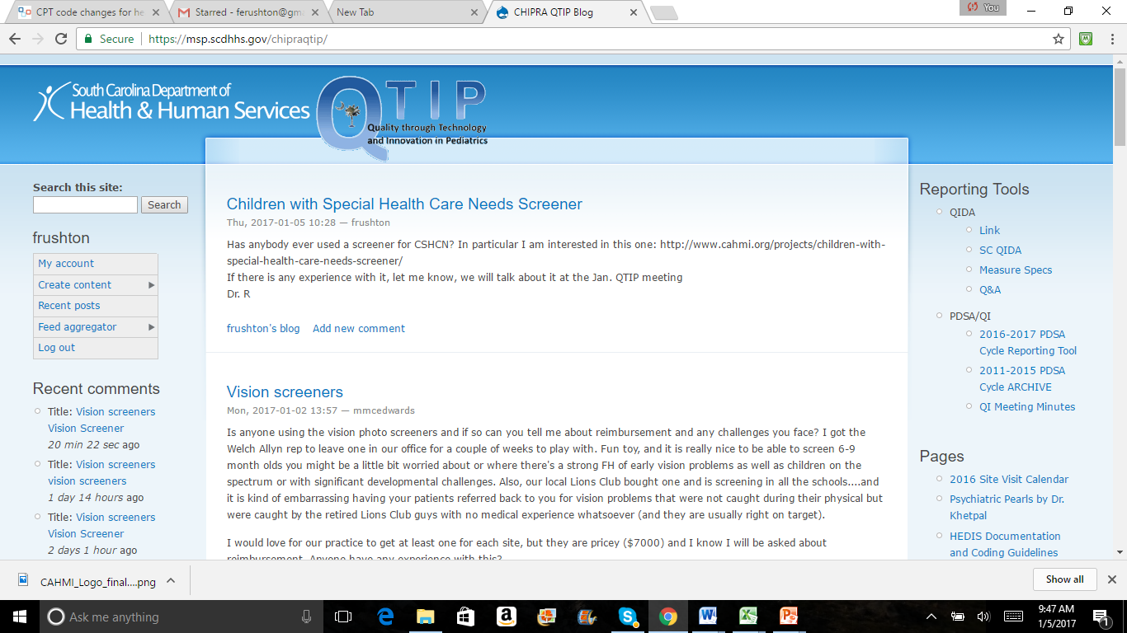

Slide 6
Family Input….
We all agree that family input into your office QI processes are important
Families have a valuable unique perspective, but depending on the issue you may need a different perspective from a different family member
Family members on QI committees are difficult but valuable, as are parent advisory committees, direct parent expertise on specific issues, surveys, e-mail conversations and virtual contacts
HOW CAN YOU MAKE YOUR OFFICE MORE FAMILY FRIENDLY

Slide 7
Emphasis on Adolescence
What QI focus do you want that reflects QTIP measures?
Well Child Visits
Behavior
Immunizations
Strengths
Obesity
Special Health Care Needs
What else would you like to focus on in your adolescent work? Let us know

Slide 8
Next Steps 2017
Fill out your evaluations
Get your practice team together and complete your next steps forms
Let Francis or Laura know if you visit date won’t work
Think about teenagers and where your opportunities are
Think about ways you can incorporate family input into your QI work
Think about your first steps in thinking through care coordination in your office
SUBMIT YOUR MOC ATTESTATION forms to Francis (FERushton@Gmail.com). Don’t forget to blog. We love entries into the PDSA cycle log and QI minutes log
Continue to give us QIDA data
Thank you

