Slide 1
Transitioning of Pediatric Patience
Deandra Clark, MD
AnMed Health, Children’s Health Center

Slide 2
AnMed Health’s Children’s Health Center
What makes us different?
Academic facility of larger hospital health system which includes multiple specialties and adult subspecialties
90-95% of provider time is clinical
Shared Med/Peds provider

Slide 3


Slide 4
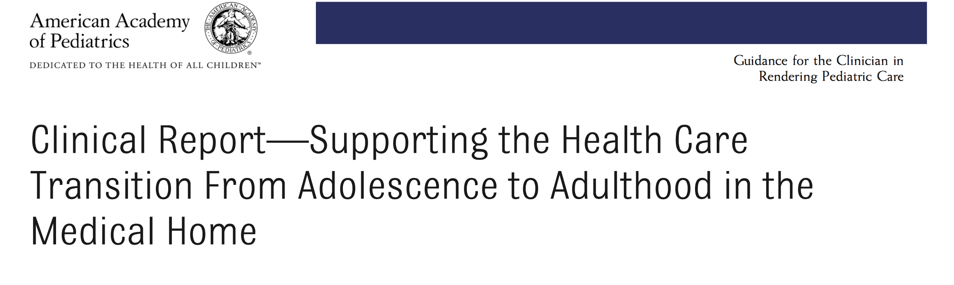

Slide 5


Slide 7
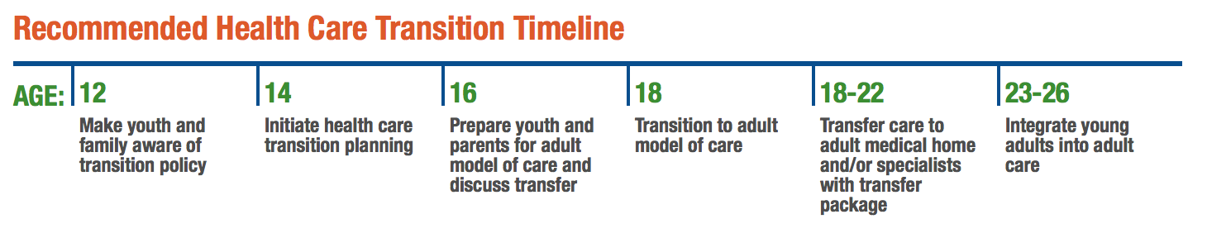

Slide 8
What we have done:
Dr. Bradford has started a “Transition Clinic” for patients with complex medical conditions (dx code Z78.9) that occurs 2 times per month
Talks have been initiated with the Family Medicine and Internal Medicine groups to accept our more complicated patients through Physician Network Services (PNS)
CHC has adopted a transition policy and taken the template policy to the PNS Counsel for the other pediatric groups to adopt
CHC gives out the “Transition Readiness Checklist” to all patients at WCC starting at age 14

Slide 9
Transition Policy

Slide 11
Transition Readiness Checklist

Slide 13
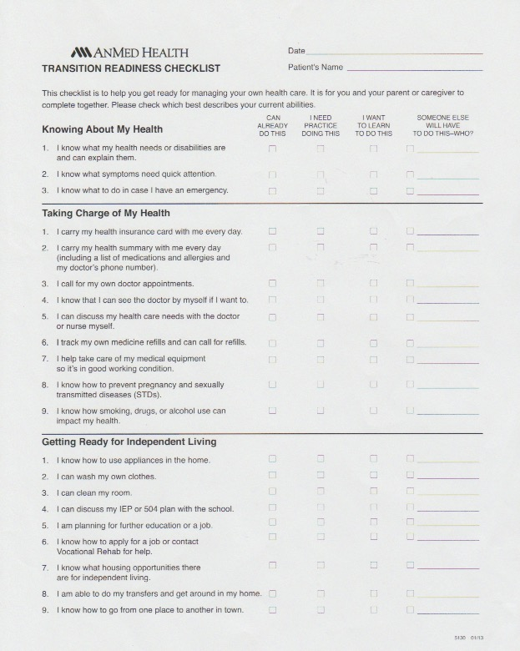

Slide 14
Our experience with Transition Checklist
It allows you to assess where your patient is in regards to self care
It allows the family and patient to see gaps that they need to address to move towards self care
Serves as a starting point for a conversation about moving into the adult world

Slide 15
Future Steps around Transitioning
Better care coordination for these patients (we would love to have a care coordinator)
Continuing to take steps to build bridges with our IM and FM colleges to take on our more complex patients so that they have a seamless transition to adult care

Slide 16
Resourses
“Supporting the Health Care Transition From Adolescence to Adulthood in the Medical Home,” http://pediatrics.aappublications.org/content/128/1/182.full
Counsel on Children with Disabilities- https://www.aap.org/en-us/about-the-aap/Committees-Councils-Sections/Council-on-Children-with-Disabilities/Pages/Policy-Resources.aspx
www.gottransition.org
“Transition Quickguide: Take Charge of Planning and Managing Your Own Health and Career Goals,” http://gottransition.org/resourceGet.cfm?id=372

