Slide 1
Carve-in Update for Community Long-term Care (CLTC) Case Managers
March 11, 2026

Slide 2
CLTC Case Manager Update
Questions from members related to incontinence supplies:
  Indicate that incontinence supplies are a service provided to members when medically necessary.
  They are now coordinated through the member’s managed care organization (MCO) for members enrolled in managed care.
  There has been no change in coverage of this service, only a change in who is coordinating the service.

Slide 3
CLTC Case Manager Update (cont.)
New referrals:
  No new referrals for incontinence supplies should be initiated through Phoenix.
  Provide information as needed to the member’s MCO so the MCO can coordinate choice of provider and provision of supplies.

Slide 4
HCBS Waiver – Incontinence Referral Process
Current Process
Waiver Case Manager
Completes assessment and develops care plan. Identifies incontinence need.
Durable Medical Equipment (DME)/Incontinence Providers (IS)
Accepts referral and completes certificate of incontinence (COI). Sends to physician for sign-off.
Physician
Receives COI. Signs diagnosis and reason. Returns to DME/IS provider.
DME/IS Providers
Receives COI and SA and processes shipment to member
Makes
referral
Service
authorization (SA).
Future Process (Proposed)
Referral Form
DME/IS Providers
- Coordinate with MCO to provide final documentation and confirm needed approvals.
- Shipment to member.
Sends demographic intake info to DME/IS provider
Sends completed COI back to DME/IS provider
Waiver Case Manager
Identifies incontinence need during assessment.
MCO
Works with member for provider choice. Facilitates DME/IS provider referral.
DME/IS Providers
Accepts referral and communicates with prescribing physician.
Physician
Provides diagnosis and deems medically necessary via COI form.
Makes
referral to designated MCO email
Sends prescriber COI.

Slide 5
CLTC Case Manager Update (cont.)
Pending referrals
  Data has been provided to MCOs on pending referrals.
  Providers will coordinate with MCOs if COI has now been received.

Slide 6
CLTC Case Manager Update (cont.)
Changes to existing authorizations or provider status.
  Coordinate with MCO to provide information if member needs a change in supplies and the MCO has not been made aware of the change.
  If you are aware that a provider will no longer be providing services, communicate this to the MCO case management point of contact so that a new provider can be selected.

Slide 7
MCO
Single Point of Contact for Case Management
MCO | Name | Email | Phone
Absolute Total Care | Felicia James | Felicia.N.James@centene.com | 803-339-3583
Healthy Blue | Jill McDonald | Jill.McDonald@healthybluesc.com HBCMReferral@bcbssc.com | 803-264-3938
Select Health | Shanice Heyward Jonathan Ward Dana Heatherly | sgraham2@selecthealthofsc.com jward@selecthealthofsc.com dheatherly1@selecthealthofsc.com | 843-529-5247 843-529-5250 843-414-3187
Molina | Christy Behearns | christy.beherns@molinahealthcare.com SCCaseManagementSupervisors@MolinaHealthCare.Com
Humana |  | Scmcdcaremanagement@humana.com

Slide 8
Phoenix Updates
Previously Shared Information
Phoenix will be updated to include new interventions that will not trigger a service need when the participant is incontinent.
  MCOs will provide incontinence supplies.
  Case managers will coordinate with the MCO.
The new interventions will be included in the Skin/Nutrition and the Activities of Daily Living (ADL) sections of Phoenix.

Slide 9
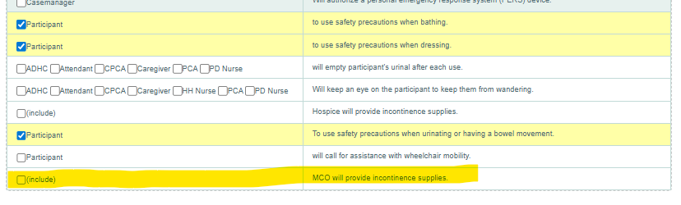
New Interventions

Slide 10
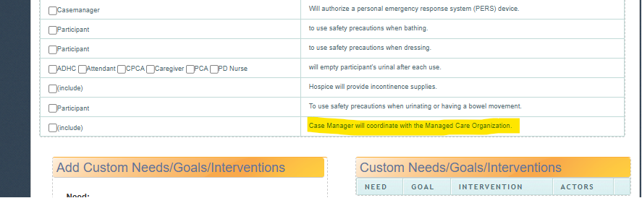
New Interventions (cont.)

Slide 11
Phoenix Updates
Interventions should be used when the participant is enrolled in a managed care plan and:
  The annual assessment, level of care (LOC) and service plan are being completed, or
  There is an update to the service plan prior to the annual assessment.

Slide 12
Phoenix Updates (cont.)
Phoenix currently has several interventions related to bowel and bladder that DO NOT trigger a need that is added to the service plan. The following interventions should be used as appropriate:
  To help the participant with caring for problems such as controlling urinating or having bowel movements.
  Will help participant urinate or have bowel movements at scheduled times.
  To use safety precautions when urinating or having a bowel movement.

Slide 13
Questions
If my participant is incontinent and there is an open authorization for supplies, what do I need to do during the annual assessment?
  Indicate the frequency of incontinence on the assessment.
  Coordinate with the MCO to determine if coordination has been completed between the MCO, provider and participant.
  Enter the two NEW interventions on the service plan.
  The South Carolina Department of Health and Human Services (SCDHHS) will notify case managers when they are to terminate existing authorizations.

Slide 14
Questions (cont.)
My participant is in managed care. On the new service plan, I accidently selected the existing intervention case manager to authorize supplies. How do I get it removed?
  You can UNCHECK the intervention prior to the state worker’s review.
  The state reviewer needs to verify that the participant IS NOT in an MCO prior to approving requests.

Slide 15
Questions (cont.)
It is not time for a new assessment, LOC and/or service plan but my participant needs a change in supplies (e.g., different size). Do I need to do anything on the service plan?
  Coordinate with the participant’s MCO. The MCO will need to issue a new authorization (if required by MCO) to the provider reflecting the change in supplies
  After coordination with the MCO you can:
    Uncheck the “CM to authorize” intervention.
    Add the two new interventions.
      The MCO will provide incontinence supplies.
      Case managers will coordinate with the MCO.

Slide 16
CLTC Case Manager Update
Previously Shared Information
Effective Jan. 1, 2026, SCDHHS added some Healthy Connections Medicaid members to the managed care service delivery model for medical services. All waiver services remain in the fee-for-service (FFS) delivery model. Medical services for members enrolled in managed care are the responsibility of the managed care plan.
Providers can find additional guidance about any changes to claims submission, payment and authorization at www.scdhhs.gov/carvein.

Slide 17
CLTC Case Manager Update (cont.)
The Healthy Connections Medicaid members who were added to the managed care service delivery model included Medicaid members who are 18 years of age or older and:
  Medicaid members who are dually enrolled in Medicare and Medicaid;
  Medicaid members enrolled in the HIV/AIDS waiver;
  Medicaid members enrolled in the Mechanical Ventilator Dependent (Vent) waiver;
  Medicaid members enrolled in the Community Choices (CC) waiver; and
  Medicaid members who reside in a nursing facility.
    Healthy Connections Medicaid members who reside in a nursing facility will now be enrolled in an MCO for coverage of medical services.

Slide 18
CLTC Case Manager Update (cont.)
Case managers should continue to check eligibility and status of enrollment in managed care through Phoenix.
  This recipient special program code will currently show if the participant is enrolled in managed care (MCHM).
  An update is pending that will show which MCO they’re enrolled in.
Service providers can check eligibility and status of enrollment in managed care through the South Carolina Medicaid Web-based Claims Submission Tool (Web Tool)
  Case management agencies may maintain this access at the agency level for specified staff to check eligibility. They can check eligibility and status of enrollment in managed care through:
    Web Tool Quick Reference Guide
    Eligibility (Visual Book)
      Verification Results screen
To set up a new account, call Blue Cross Blue Shield at (888) 289-0709 during regular business hours.
Members enrolled in managed care will receive a new Healthy Connections Medicaid member card from their MCO.

Slide 19
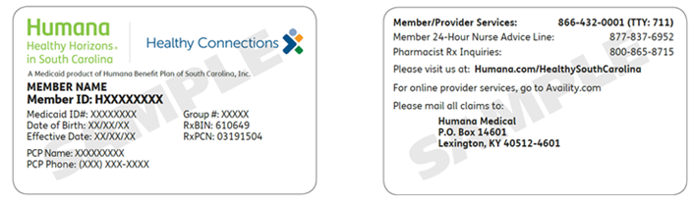
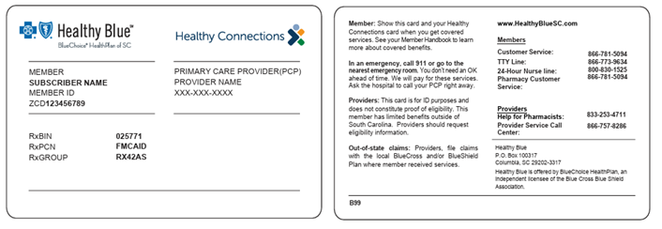
MCO Sample Member ID Cards

Slide 20
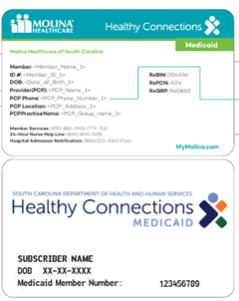
MCO Sample Member ID Cards (cont.)

Slide 21
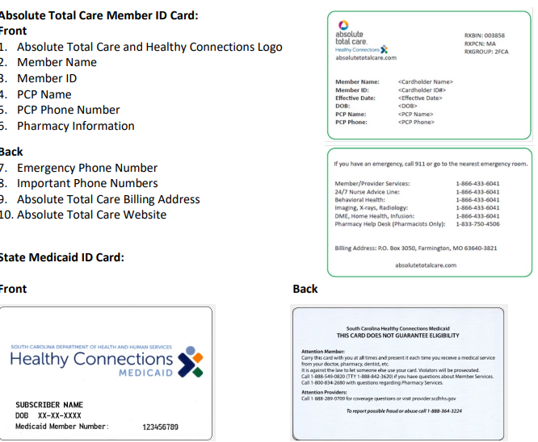
MCO Sample Member ID Cards (cont.)

Slide 22
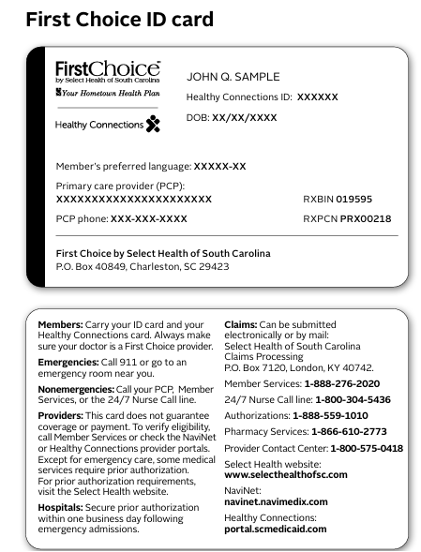
MCO Sample Member ID Cards (cont.)

Slide 23
CLTC Case Manager Update (cont.)
Waiver services will continue to be authorized through the FFS delivery model. However, for dates of service on and after Jan. 1, 2026, claims for medical services for members who are enrolled in the HIV/AIDS, Vent or CC waiver programs should be submitted to the MCO in which the member is now enrolled.
Claims for incontinence supplies need to be billed directly to the member’s MCO.
Claims for nutritional supplements (X1939), hand-held shower (T2028) and specialized medical equipment and supplies (X1917 and X1918) need to be billed to FFS Medicaid (no change to current billing process).

Slide 24
CLTC Case Manager Update (cont.)
Medical services include the following:
  Inpatient and outpatient hospital services;
  Clinic services;
    Including rural health clinic and federally qualified health clinics services.
  Early and Periodic Screening, Diagnosis and Treatment services;
    For members under the age of 21.
  Physician services;
    Including medical care provided by other practitioners such as nurse practitioners, physician assistants and others.
  Podiatry services;
  Chiropractic services;
  Home health care services;
    Including incontinence supplies.
  Rehabilitative therapy services;
    Physical, occupational, speech/language therapies.
  Pharmacy services;
  DME; and
    Including IS.
  Behavioral health services.

Slide 25
Waiver and Medical Services Chart
A chart is available at https://www.scdhhs.gov/carvein that outlines CC, HIV/AIDS and Vent waiver services and medical services.

Slide 26
Waiver and Medical Services Chart (cont.)
Waiver Services Covered by the FFS delivery model | Community Choices | HIV/AIDS | Mechanical Ventilator
Adult Attendant Care Services | ✓ | ✓ | ✓
Adult Day Health Care Services | ✓
Adult Companion Services | ✓ | ✓
Adult Day Health Care Nursing | ✓
Environmental Modifications | ✓ | ✓ | ✓
Home-delivered Meals | ✓ | ✓ | ✓
Nursing Services |  | ✓ | ✓
Personal Care Services | ✓ | ✓ | ✓
Personal Emergency Response System | ✓ |  | ✓
Pest Control Treatment | ✓ | ✓ | ✓
Residential Personal Care II | ✓
Respite Care | ✓ |  | ✓
Specialized Medical Equipment and Supplies (nutritional supplements and handheld showers) | ✓ | ✓ | ✓
Telemonitoring | ✓
Waiver Case Management | ✓ | ✓ | ✓

Slide 27
CLTC Case Manager Update
Existing Authorizations
Monitor status updates for Healthy Connections Medicaid members newly enrolled in managed care (Phoenix).
Maintain documentation per current policy and procedures
Update service plan per policy and procedure
Coordinate incontinence supply transition with member and incontinence supplies provider.
Identify MCO using Web Tool until Phoenix is updated with new plan-specific indicator.
Maintain authorization until IS provider has fully transitioned authorization to MCO with no breaks in service.
Once transitioned, incontinence supplies service is managed by MCO outside of Phoenix.
ADLs and Skin/Nutrition section of assessment.
Once existing authorization is fully transitioned, Waiver Supports on service plan will no longer include open authorizations for incontinence supplies.
Waiver supports on service plan may include nutritional supplements (waiver service) if authorized for member.

Slide 28
CLTC Case Manager Update
Existing Authorizations In Process or With Changes
If an incontinence supply provider has started services, maintain authorization until incontinence supply provider has fully transitioned authorization to MCO.
Changes to existing authorizations should be redirected to the MCO through the MCO prior authorization and provider help lines for providers, or through case management point of contact for case managers.
If authorization is pending because incontinence supply provider is waiting for return of prescriber’s form (DHHS Form 168IS), ensure incontinence supply provider has coordinated transition of authorization with MCO.
Goal is to prevent delay or break in service.

Slide 29
CLTC Case Manager Update
New Referrals for IS
If no provider has been selected, assist with coordinating member with point of contact at MCO.
MCO will authorize and monitor incontinence supplies for member.
Ensure MCO is aware of member’s need for service.
If new referral is received and no actions have been taken to initiate incontinence supply application, do not complete IS application. Select new interventions in Phoenix.
Use the MCO Case Management single point of contact.

Slide 30
CLTC Case Manager Update (cont.)
The MCOs are responsible for a 180-day continuity of care period for newly enrolled MCO members. It is important that providers continue to deliver authorized services. During this continuity of care period, MCOs are required to:
  Honor all previous prior authorizations without requiring additional authorization from providers; and
  Pay previously authorized services at 100% of the applicable Medicaid FFS rate, unless a contractually negotiated rate exists, regardless of whether the provider is in-network with the MCO.
Once the continuity of care period is over, providers must be enrolled with the MCO in which the Healthy Connections Medicaid member is enrolled.

Slide 31
CLTC Case Manager Update (cont.)
Points of contact and information on prior authorization and enrollment/credentialing for each South Carolina MCO is available on SCDHHS’ website and below.
MCO prior authorization and provider help lines:
  Absolute Total Care: (866) 433-6041
  First Choice by Select Health: (888) 559-1010
  Healthy Blue by Blue Choice of SC: (866) 757-8286
  Humana Healthy Horizons of SC: (866) 432-0001
  Molina Healthcare of SC: (855) 237-6178

Slide 32
MCO Enrollment and Billing Processes
Single Point of Contact for Contracting, Credentialing, Claim Submission
MCO | Name | Email | Phone Number
Absolute Total Care | Jennifer Helms | Jennifer.B.Helms@centene.com | (803) 206-2800
Healthy Blue | Tammy Betts | Tammy.Betts@bcbssc.com | (803) 264-9667
Select Health | Nacy Carey Jill Dunnigan | NCarey@selecthealthofsc.com JDunnigan@selecthealthofsc.com | (843) 300-5857 (843) 607-5649
Molina | Tyler Stalvey | Tyler.Stalvey@molinehealthcare.com SCGovtContracts@molinehealthcare.com | (803) 667-8695
Humana | Kryshinda Miles | KMilies21@humana.com | (803) 346-6009

