Slide 1
Provider Compliance Office Hours
Officer of Waiver Quality Assurance and Compliance
South Carolina Department of Health and Human Services (SCDHHS)
Oct. 20, 2026

Slide 2
Welcome
Question and answer (Q&A) can be accessed in the top left corner of your screen. This will be utilized for questions. Chat and video have been disabled.
If you do not have access to the Q&A, please email BOQTraining@scdhhs.gov.
We will get started shortly.

Slide 3
Purpose
This webinar will provide an overview of the health information and attendance logs for Adult Day Health Care (ADHC).
Address the process for completing task sheets or submitting resolutions for Personal Care Services (PCS).
We would love to know any topics you would like us to discuss during these monthly meetings. ​
Email BOQTraining@scdhhs.gov with any suggestions or include in the survey at the end of the meeting.

Slide 4
Frequently Asked Questions (FAQs)
SCDHHS has completed an FAQ document that can be located on the Office of Waiver QA & Compliance site: Waiver QA, Training, and Compliance.
Please refer to the FAQ for questions and answers.
If a question appears in the Q&A section multiple times, we will refer to the FAQ after the third explanation.

Slide 5
ADHC

Slide 6
Documentation for ADHC Staff and Members
Health Information
Attendance Logs
Records are stored in a central and locked location.
Therapy and medication schedules, records and special diets must be in a private and secure location.
The provider must maintain a daily attendance log. It documents the arrival and departure time of each participant.
A separate log must be kept indicating staff in attendance and their arrival and departure times.

Slide 7
PCS

Slide 8
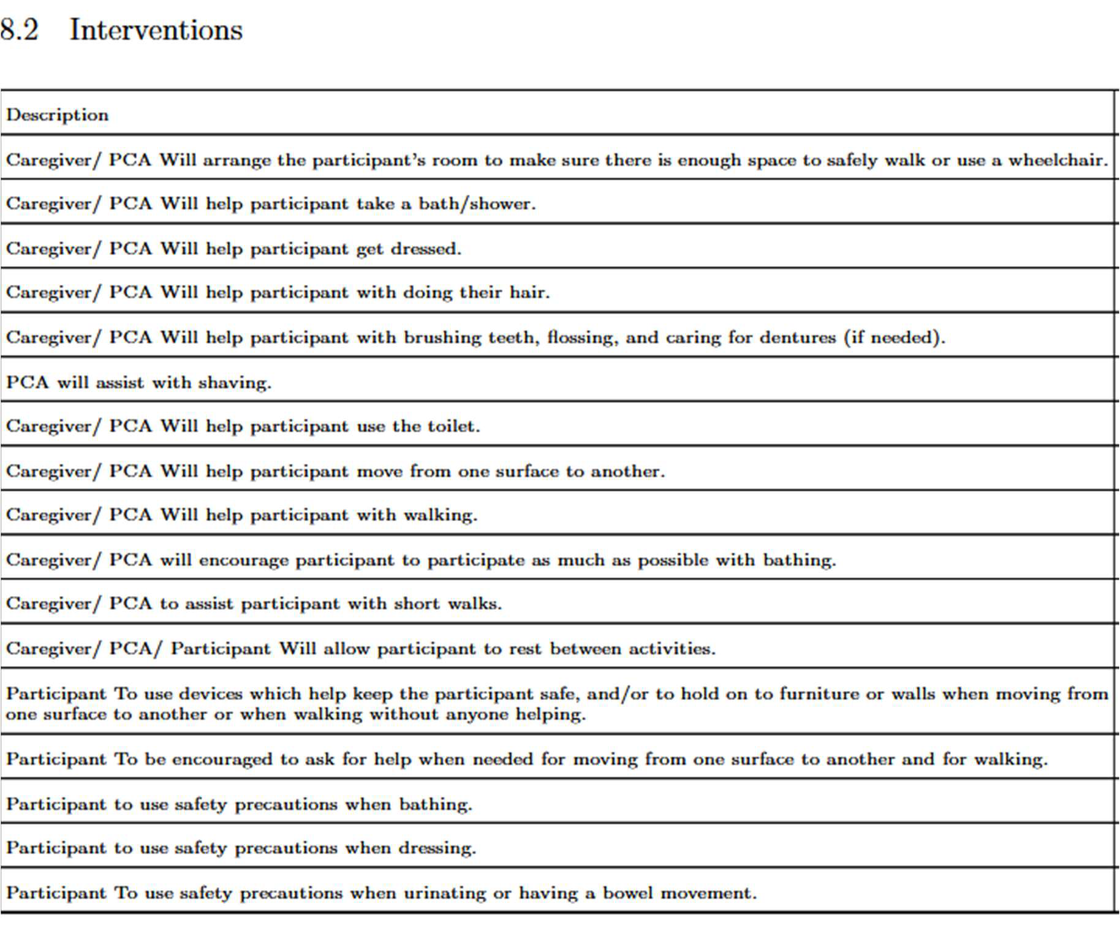













Task Sheets
The ‘Interventions’ section of the SCDHHS Service Plan have the services that the aide is to assist the participant with.
These are the tasks that the nurse supervisor will utilize to develop the task list for the aide.
Aide should document that these are completed on the daily task sheets.
Aides should not assist with Activities of Daily Living (ADLs) that are not listed as a need in the service plan.
If the service plan does not meet the need of the participant, providers should contact the case manager (CM) via Phoenix Conversation to inform them of the participant change in status.

Slide 9
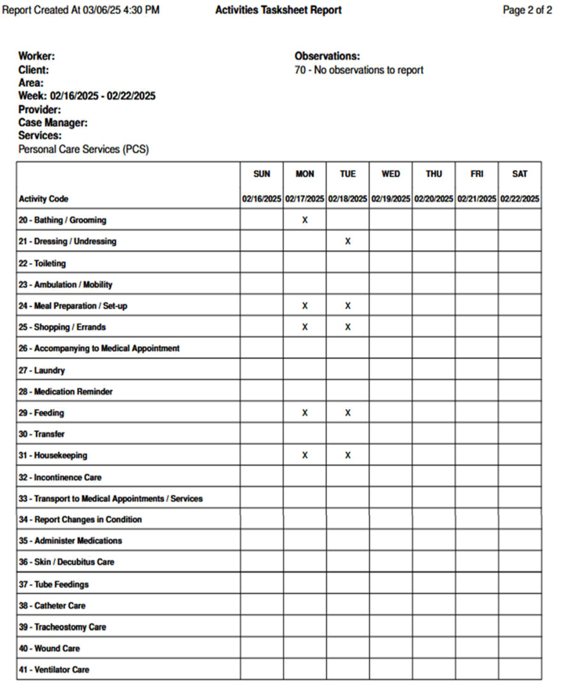
Task Sheets (cont.)
Task sheet must be completed for every date that services are billed.
Can include multiple services on the same task sheet if services can be easily identified, and the tasks performed can be distinguished.
Must be reviewed for accuracy, signed with an original signature and dated every two weeks by the nurse supervisor.
  Nurse supervisor should address any concerns with the aide.
    Possible Concerns
      Services do not reflect tasks outlined in the service plan.
      Dates that tasks are not documented.
      Skilled services indicated.

Slide 10
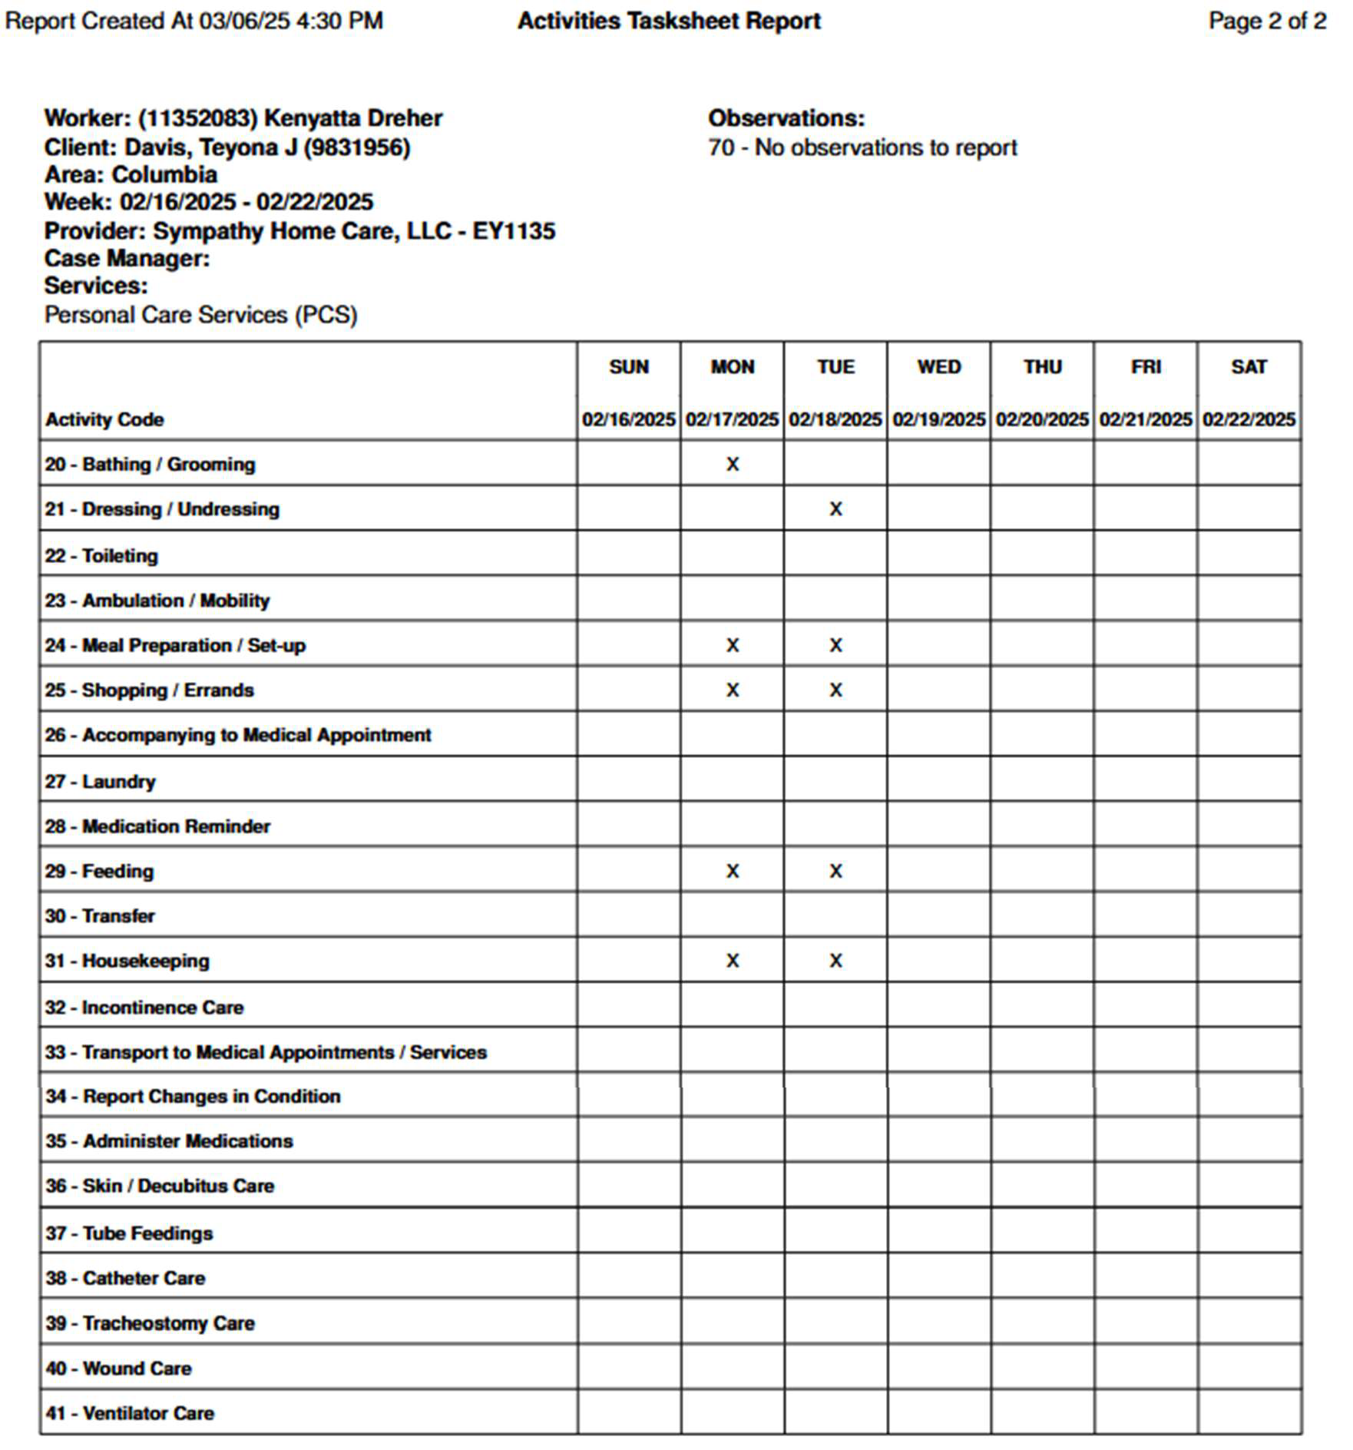
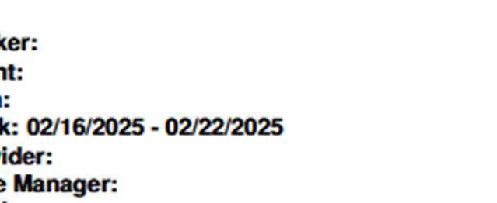
Task Sheets (cont.)
Task sheets must be filed in the participant’s file within 30 days of service delivery.
Do not have participants sign or date the task sheets.

Slide 11
Task Sheets (cont.)
Activities task sheets in Phoenix can be utilized as your task sheets.
Phoenix activity task sheet reports have the ‘Report Created At’ at the top of the report. Provider must print weekly so that nurse supervisor can sign within two weeks of service provision. Do not backdate the signatures.
When resolutions are submitted, there is no way to document tasks during the resolution process. The date will appear blank on the report.
Nurse supervisor should document the tasks on the report.
Nurse supervisor should initial and date any changes to the report that are made.
Paper task sheet can be utilized if provider chooses.

Slide 12
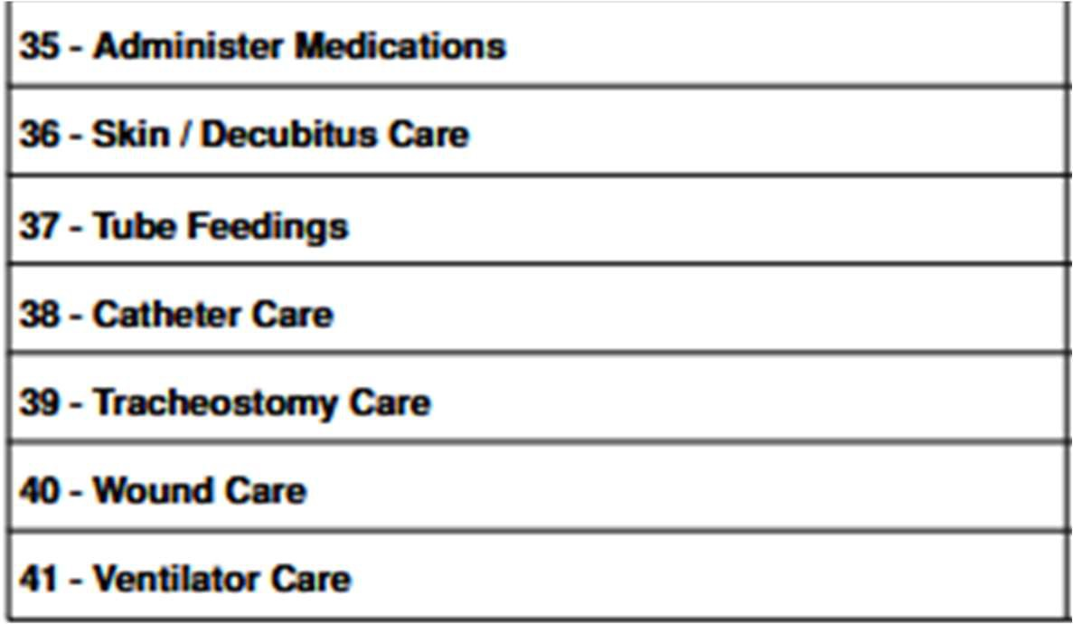
Task Sheets (cont.)
Please inform your staff when they clock out of the Electronic Visit Verification (EVV) system, they should not select anything after number 34, “Report Changes in Condition.”
Numbers 35 – 41 are tasks that are considered skilled care.
Under no circumstances should any type of skilled medical service be performed by an aide.

Slide 13
Survey Questions

Slide 14
Questions from Survey Results
Why are providers receiving deficiencies for completing tasks on the list under the needs and goals on the service plan?
  Compliance reviews are based on the interventions documented in Section 8.2 of the SCDHHS Service Plan. For example, if toileting and incontinence care is listed under needs and goals, this only identifies the participant’s need and does not authorize a personal care aide (PCA) to provide those tasks.
  If the participant requires this assistance, it must state in Section 8.2 that the children’s personal care aide/PCA will help with incontinence care. If it is not documented, the aide should not perform or record the task.
  The CM should update the service plan if this support is needed.

Slide 15
Questions from Survey Results (cont.)
What are the requirements for the plan of care for PCS? Are goals required?
  No plan of care is required for PCS. Requirements include:
    An SCDHHS Service Plan, formerly referred to as the CLTC Service Plan, in the participant’s file.
    New service plans are completed annually by the case manager.
    The ‘Interventions’ section of the SCDHHS Service Plan has the services that the aide is to assist the participant with.
    The needs and goals listed on the service plan do not authorize the aide to complete the task.
    The nurse supervisor is required to create a task list based of the service plan.

Slide 16
Questions from Survey Results (cont.)
What are the requirements for the plan of care for nursing services? Are goals required?
  A plan of care must be developed by a registered nurse and must be given to the CM upon request.
  Treatment and goals should be included in the plan of care.
  Nurses must sign prior to implementation.
  Plans not signed by the physician/nurse appropriately will not be accepted.
  Must be updated at least every 90 days.
  Physicians must sign either prior to implementation or within 30 days of verbal orders.

Slide 17
Questions from Survey Results (cont.)
Who puts in the authorization for hospice and personal care services? We are having trouble getting paid with a code of 976.
  The CM puts in the prior authorization for hospice in Phoenix.
  The hospice provider must coordinate the service with the personal care provider and submit the form 160 to the CM.
  If you are receiving 976 codes, please contact the CM.

Slide 18

Questions

Slide 19

Survey

