Slide 1
Program Area Webinar Series
Home Again Program
Division of Community Options
March 5, 2021

Slide 2

Topics
Program Overview
Program Process
Program Statistics
Home Again and CLTC Programs
Next Step: Waiver Amendments

Slide 3
Program Background
National grant name is “Money Follows the Person (MFP) Rebalancing Demonstration”
Helps States rebalance their long-term care systems to transition people with Medicaid from institutions to the community.
The Deficit Reduction Act of 2005 established $2 billion in funding
  January 2007, 17 states received demonstration awards
  As of November 2017, 43 states and the District of Columbia are implementing MFP programs.
From Spring 2008 through fall 2017, over 75,000 people have transitioned back into the community through MFP Programs

Slide 4
Program Goals
Increase the use of home and community-based services (HCBS) and reduce the use of institutionally-based services
Eliminate barriers in State law, State Medicaid plans, and State budgets that restrict the use of Medicaid funds to let people get long-term care in the settings of their choice
Strengthen the ability of Medicaid programs to provide HCBS to people who choose to transition out of institutions
Put procedures in place to provide quality assurance and improvement of HCBS

Slide 5

Why Home Again?
Most desired site of care
Bypass waiver waiting list
Address Housing needs
Rate Comparison
  Average NF Daily Rate: $171
  Average HA Daily Rate: $62

Slide 6
Why Home Again?
Cost Savings
  SC Nursing Facility Average Daily Rate: $171
  Home Again Average Daily Rate: $62
$171 X 365 days X 96 individuals
= $5,991,840
$62 X 365 days X 96 individuals
= $2,172,480
Savings for serving individuals in the community rather than in NF
= $3,819,360 per year

Slide 7
Why Home Again?
Home Again program participants stay, on average, 704 days in a Skilled Nursing Facility prior to transitioning to the community
The longest stay in a Skilled Nursing Facility was 6,475 days or 17.7 years among Home Again participants
With the longest stay of 17.7 years, the program could have saved $796,099 for the individual

Slide 8
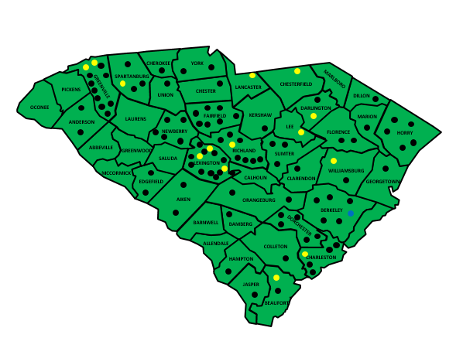
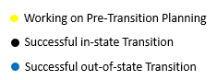
Home Again Map as of October 2017

Slide 9
Home Again Statistics
685 Home Again Referrals from Sep. 2012 to Nov. 2017
96 individuals transitioned to the community (14%)
28 individuals transitioned to the community in 2017
330 assessments were completed
Main Reasons for termination after assessment
  Lack of family support
  Difficulty in finding housing
  Deteriorating health conditions
  Lack of community resources to meet the medical needs

Slide 10
Referrals by County

Slide 11
Transitions by County

Slide 12
Program Eligibility
To be eligible for the program, a person must:
Currently reside in a qualified institution (Nursing Facility or Hospital)
Have been in the institutional setting for at least 60 consecutive days*
Be on South Carolina Medicaid payment for at least one day before transitioning
Meet skilled or intermediate Level of Care
* The person can count hospital stays as part of the 60 days, but the person needs to be admitted into the nursing facility at the time of transition (for at least one day).

Slide 13
HCBS Qualified Services
Qualified HCBS Services can be overlapped with Home Again Program
Qualified HCBS Services are:
  Community Choices Waiver
  HIV/AIDS Waiver
  Mechanical Ventilator Waiver
  Dual Eligible Program (HCBS portion only)
We are working to add HASCI Waiver as one of the qualified HCBS services

Slide 14
Home Again Services
Home Again Services
  Transition Coordination
  Expanded Goods and Services
    Furniture up
    Appliances
    Initial Groceries
    Security Deposits
    Utility Deposits
    Household items
    Other non-covered items
Home Again program is assisting with housing and other issues in order to make successful transitions as well.

Slide 15
Transition Coordination
Definition:
  Transition coordinator is responsible for providing service counseling and assisting participants in coping with changing needs. The transition coordinator will also assist the participant with decisions regarding a successful transition into the community. The transition coordinator will also ensure continued access to appropriate and available services for participants.

Slide 16
Transition Coordination Qualification
Qualifications
  A - Licensed Master Social Worker (LMSW)
  B - Licensed Baccalaureate Social worker (LBSW)
  C - Registered Nurse (RN)
  D - Case Manager Certified (CMC)
  E – Bachelor Degree in Human Services (BHS)
Must have demonstrated at least two (2) years of case management experience with one of the Home Again target populations; either older adults or people with physical disabilities.

Slide 17
Transition Coordination Service
Responsibilities (including but not limited to):
  Obtain informed consent from participant and/or his/her legal representative if participant has been determined incompetent
  Assess participants medical, financial, and housing situation
  Assist to develop a service plan with the participant
  Conduct Risk Assessment and Mitigation Plan
  Determine whether the participant is moving into a “qualified residence”
  Maintain a 24/7 backup plan for critical services (as is requirement to be a provider)
  Conduct psychosocial assessments of the participant
  Evaluate Durable Medical Equipment (DME) needs of the participant
  Assist Transition Coordinator Manager to create referrals and authorizations that’s addressed on Service Plan
  Provide individual health education training for the participant and caregivers

Slide 18
Transition Coordination Service
Responsibilities (including but not limited to):
  Conduct home visits of the participant
  Monitor transition and medical needs of the participant
  Facilitate transition meetings for the participant
  Explain to the participant the types of community long term services and supports
  Assist the participant with housing needs
  Build and maintain good working relationships with waiver staff, Nursing Facility staff, service providers, clients, caregivers and etc.
  Keep Quality Assurance personnel closely updated on transition activities on a monthly basis
  Complete Transition and Discharge Checklists for participant
  Any additional work required by waiver and Home Again staff

Slide 19
Transition Coordination Service
Visitation Schedule
  During the first two (2) months:
    two (2) face-to-face visits, and
    two (2) telephone calls per month.
  During months 3-12:
    one (1) face-to-face visit every other month, and
    one (1) monthly telephone call.

Slide 20
Transition Process
Home Again Referral is made.
Centralized Intake processes the referral.
Home Again team contacts NF to receive Eligibility Packet.
Home Again Transition Coordinator Manager conducts initial assessment.
Case transferred to Area Office and the assigned NC completes LOC.
TC Manager obtains TC provider choice and completes TC referrals/authorization.
Case transferred to CM II and CM II completes Service Plan when notified.
TC Manager creates referrals and authorizations for Home Again demonstration services and Waiver services.
The participant transitions to the community.
CM II obtains CM provider choices and create CM referrals/authorization upon enrollment.
  Note: Case Managers working with Home Again participants should not complete the waiver re-evaluation showing in Phoenix.

Slide 21


Home Again Timeframe
Pre-Planning
Home Again Program
HCBS Qualified Services
Transition
365 days

Slide 22
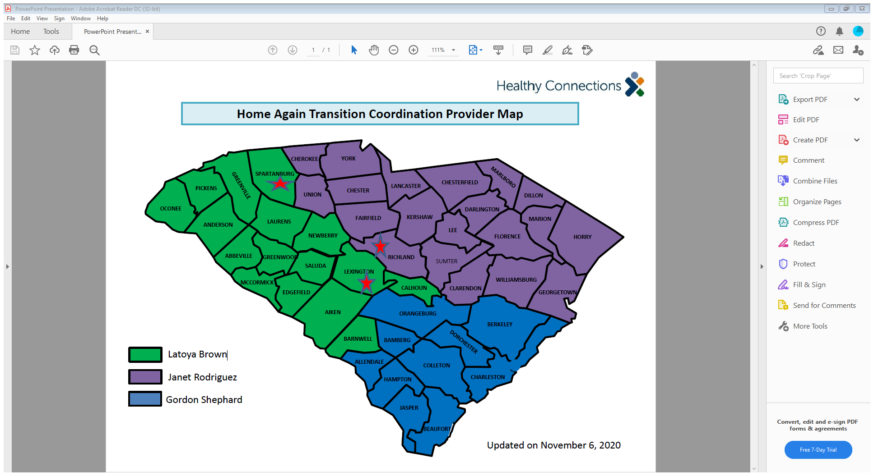
Transition Coordination Map

Slide 23
Expanded Goods and Services
Participants are eligible for all waiver services including environmental modifications as part of waiver services.
Expanded Goods and Services may cover items such as:
  Furniture
  Appliances
  Initial Groceries
  Security Deposits
  Household items
  DME deemed necessary and not covered by either Medicare or Medicaid DME

Slide 24
Housing Coordinator Roles
Primary focus to identify and expand the pool of affordable and accessible housing opportunities for Home Again applicants and participants statewide.
Responsible for outreach to the network of housing entities, including public housing authorities and private landlords, in an effort to better serve individuals needing long term care that will allow them to receive services in their community rather than in a long-term facility.
Responsible for networking and building a collaborative relationship with local housing authorities, community development corporations, developers, and other housing related entities to promote the development and identification of affordable and accessible housing opportunities that meet the requirements of the Centers for Medicare and Medicaid Services.

Slide 25
Qualified Residence
A home owned or leased by the individual or the individual's family member; the lease/deed must be held by the individual or the individual’s family member
An apartment with an individual lease, with lockable access and egress, and which includes living, sleeping, bathing, and cooking areas over which the individual or the individual's family has domain and control
A residence, in a community-based residential setting, in which no more than 4 unrelated individuals reside
  A residence in which no more than 4 unrelated individuals reside and that is part of a larger congregate care setting (campus) separated from typical community dwellings would not be considered a qualified residence.

Slide 26
Transitions by Housing Type
Home Owned by Participant or Family Member: 70
Leased Apartment: 26
Community Based Residential Setting: 0

Slide 27
HUD Affordability Standard
The HUD affordability standard suggests that a tenant pay no more than 30 percent of his or her income for rent and utilities (not including telephone or cable). The Home Again program has adopted this standard to determine affordability for individuals requesting housing assistance.
In 2016, a person living on Supplemental Security Income (SSI) in Columbia only receives $733.00 a month. This means that SSI beneficiaries are living at 30% below the federal poverty level or at the extremely low income end. With this money they must pay rent, transportation, groceries, utilities, and when possible other miscellaneous items.

Slide 28
Bridge Rental Subsidy
There are multiple ways to fund affordable housing.
One way SCDHHS has attempted to address this need is through the Bridge Rental Subsidy program.
SCDHHS has a contract with State Housing to administer this program.
The main objective of this program is to provide rental assistance for our extremely low income Home Again participants for up to 24 months, while on the waiting list for Housing Choice Voucher, Public Housing and Project Based apartments.
Participants must show proof that they have been placed on at least three (3) waiting list.

Slide 29
Challenges
The following challenges can prolong the transition to affordable housing:
  Outstanding Utility Bills
  Prior Evictions or unpaid rent balances
  Poor Credit History
  Prior Criminal History
  Missing birth certificate and/or SC photo ID and/or Social Security Card
  Obtaining a current Social Security benefit letter
  Lack of family support

Slide 30

Client Satisfaction Survey
Satisfaction & Experience Study Overview:
  The study aimed to identify strengths of the Home Again program and areas for improvement by examining programmatic areas including interactions with the Transition Coordinator, participant self-direction, and satisfaction.
Program Satisfaction:
  Almost all survey respondents were ‘extremely’ satisfied with the Home Again program and the CLTC Community Choices Waiver program, the program to which most are transitioning.

Slide 31
Client Satisfaction Survey
Transition Coordination:
  Overall, Transition Coordinators are rated highly by program participants. Transition Coordinators seem to be doing an outstanding job of building professional and respectful relationships with Home Again participants and caregivers. Survey respondents reported high satisfaction with Transition Coordinators and rated response times well indicating that when they needed to talk outside of normal visits that they could reach Transition Coordinators immediately.
Person Centered Planning:
  Most respondents felt that they had choices, and most thought that the Transition Coordinators explained how they could be involved in making choices. However, ratings dropped slightly when asked if they had a say ‘all of the time.’ While most believed that they could include their personal goals during planning, only half of the respondents said that they could include ways to achieve their personal goals ‘all of the time.’

Slide 32
Quality Of Life Data Analysis
QoL Data Analysis Overview:
  In addition to the Satisfaction & Experience study, secondary data analysis was conducted on the Quality of Life (QOL) data which is collected by the Home Again staff at three program intervals, pre-transition, 11 months post-transition, and 2 years post-transition.
Living Arrangements, Choice, and Control:
  Fewer than half of participants reported that they liked where they lived pre-transition, while most reported that they liked where they lived post-transition. For the most part, choice and control seemed to increase as length of time transitioned into the community increased. Choice and control increased from the baseline measure to the first survey post-transition.
Access to Personal Care:
  The overwhelming majority of participants indicated that they needed some type of assistance with activities of daily living (ADLs), and most of the people providing the care were paid. The number of informal care hours provided by friends and family declined by 4 hours from 11 months post transition to 2 years post transition. Approximately one-quarter of participants who are at the two year mark for post-transition report that they need more help with personal care than they are currently receiving. This could be indicative of a need for more caregiver support so that informal caregivers can continue to support those who have transitioned successfully.

Slide 33
Quality of Life Data Analysis
Community Integration & Inclusion:
  At each QOL survey administration, most people reported being able to get places that they needed to go. They also reported being able to see family and friends when they wanted. Few report needing more help to get around the community; however, around half of participants said that they would like to do more activities outside of their facility/home.
Participant Well-being:
  Around one-third of participants reported having symptoms of depression, such as feeling sad and/or irritable at the first and second surveys. This pattern decreased some at the second survey, but irritability decreased significantly by the third survey. These patterns suggest that some aspects of participant wellbeing increase the longer that they remain in the community.

Slide 34
Home Again and CLTC Programs
Require Skilled Nursing Facility Level of Care.
Transition Coordination vs Case Management.
Focus on on-going monitoring for safety, welfare and etc..
Emphasize Person-centered approach.
Pursue conflict free case management.
All Home Again participants receive waiver services.
Got a common goal: Supporting individuals to sustain in the community.

Slide 35
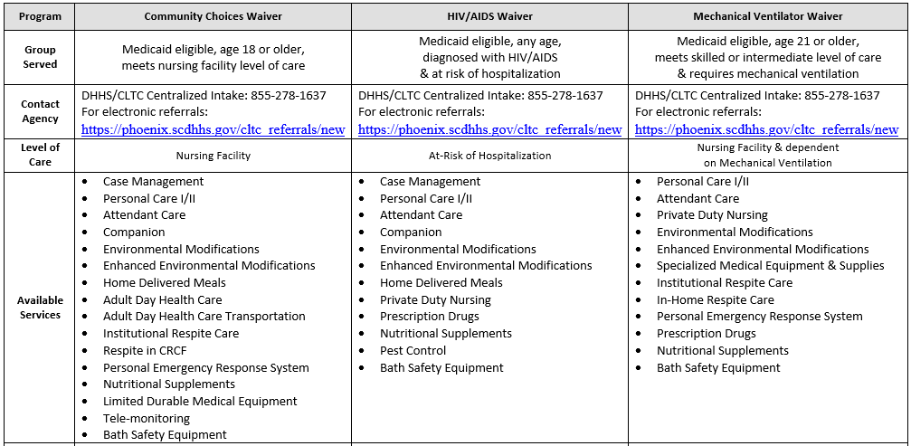
Home Again and CLTC Programs

Slide 36
Next Step: Waiver Amendments
SCDHHS is proposing to maintain the Home Again program under the 1915 (c) Medicaid authority.
Planning to retain the Home Again program and the two demonstration services through three existing 1915 (c) waiver amendments (Community Choices, Mechanical Ventilator, and HIV/AIDS).
Will maintain the target population, the eligibility requirements and the qualified institutions for transition activities.

Slide 37
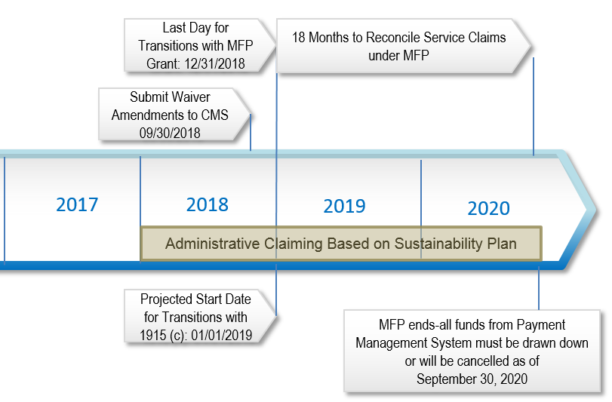
Proposed Timelines for Waiver Amendments

Slide 38

Home Again Success Story

Slide 39
Questions
Questions

Slide 40
Contact us
HomeAgain@scdhhs.gov

