Slide 1

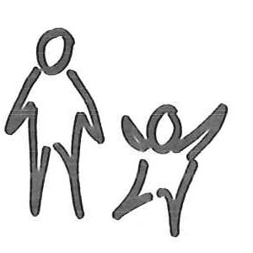





Please bring to the exam room to review with the doctor
Have you smoked a cigarette, even a puff, in the last 30 days?
Yes No
Would you like to receive FREE resources from the Tobacco Quitline?
Yes No Not sure
Would you like nicotine patch and gum to help you cut down or quit smoking?
Yes No Not sure
Document Tobacco Use/Exposure
  Tobacco users: Mother Father Patient Other
  Smoke-free home rule: Yes No
  Smoke-free car rule: Yes No No car
Document Services Provided
  Prescription given for patch and/or gum to:_________________
  Enrolled in the Quitline
  Enrolled in SmokefreeTXT
  Set a quit date for __________________________
Step 1: For the parent/patient to fill out
Step 2: For office use (EMR Entry)
Code 65.22 to document parental tobacco use/assistance (Toxic effect of tobacco)
Code Z77.22 to document any suspected tobacco smoke exposure
Code F17.200 to document teen tobacco use/assistance (Nicotine dependence)
Call 1-800-784-8669 for free help quitting
OR
Text the word “QUIT” (7848) to IQUIT (47848) for free help.
Text the word “QUIT” (7848) to IQUIT (47848) for free help
OR
Call 1-800-784-8669 for free help quitting.
Center for Pediatric Medicine
20 Medical Ridge Dr.
Greenville, SC 29605
(864)220-7270
Center for Pediatric Medicine
20 Medical Ridge Dr.
Greenville, SC 29605
(864)220-7270
Name _________________________ Date __________
Name _________________________ Date __________
Address ___________________________ D.O.B. ________
Address ___________________________ D.O.B. ________
Nicotine patch (check strength)
☐ 21mg ☐ 14mg ☐ 7mg
Apply 1 patch for 16-24 hours each day
Nicotine gum
☐ 4mg
Chew one piece every 1-2 hours
Dispense 2 months supply
Refill NR 1 2 3 4 5
Dispense 2 months supply
Refill NR 1 2 3 4 5
Prescription is void if more than one (1) prescription is written per blank.
Prescription is void if more than one (1) prescription is written per blank.
_____________________
Dispense as written
________________________
Generic substitution permitted
_____________________
Dispense as written
________________________
Generic substitution permitted

