Slide 1




A Lifestyle Medicine Approach to Pediatric Obesity in the Medical Home
QTIP Fall Workshop Sept 22, 2021
Erin L Brackbill, MD, FAAP, dipABLM
erin.brackbill@prismahealth.org

Slide 2

I have no disclosures

Slide 3
OBJECTIVES
Understand the challenges and patterns in pediatric obesity that motivated our changes
Recognize our guiding, evidence-based principles
Understand the application of our office flow algorithm
Learn key concepts that are easily applied in practice
  Behavioral Change
  Lifestyle Medicine, focusing on WFPB nutrition
Discover ways to integrate new ideas in a busy practice

Slide 4

How we got started
Opportunity to Collaborate: Center for Pediatric Medicine (CPM) was ready to improve their approach to pediatric obesity. I joined CPM after working 8 years at a multidisciplinary pediatric obesity program and I was finishing my fellowship in Lifestyle Medicine. We were excited to innovate and collaborate on ways to improve our care pediatric patients with obesity in the medical home.
Task Force Planning: Our leadership at CPM pulled together a task force in late 2019. Our goal was to make the process better for both providers and patients. Rollout over 2020-2021.

Slide 5

Big Challenges = Big Opportunity for Innovation
Obesity is THE most prevalent chronic disease in pediatrics
Many practices lack a consistent approach among providers
Other Challenges in Practice: obesity is a complex disease, time-consuming visits, provider bias, barriers to resources for many patients (Health Disparities and SDH), and many providers lack training in evidence-based behavior change counseling and evidenced based nutrition...

Slide 6
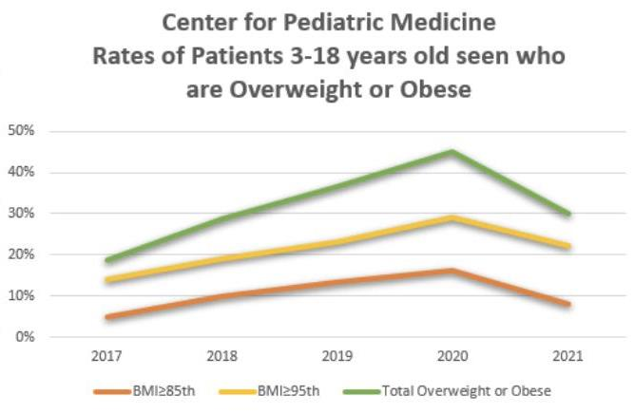

​​
Big Challenges = Big Opportunity for Innovation
Notes:
We created a task force that started meeting in late 2019 and we started rolling out these changes in January 2020. Little did we know how MUCH we would need these efforts in place with the dramatic increase in obesity/overweight due to the covid pandemic. We saw the numbers in our office increase to 45% by 2020. While we realize some of this increase is due to factors like increase snacking and sedentary time, decreased activity, ,we also know that stress has played a large roll in this increase, and the STD have been magnified as we see racial, ethnic and lower SE groups disproportionately affected during this pandemic.

Slide 7
Guiding Evidence-Based Principles
Obesity must be viewed as a complex, chronic disease
The medical home is the most effective setting to manage chronic disease
AAP IHCW framework for approaching overweight/obesity (updates in 2022)
Motivational Interviewing is effective in children and families with obesity
Lifestyle Medicine provides a comprehensive model for prevention and treatment of chronic disease and takes into consideration the social and emotional issues impacting obesity and other chronic diseases

Slide 8

Our Approach Centers Around 3 Main Ideas
FLOW An office flow for pts with BMI >85% to improve consistency and follow up
STAGE OF CHANGE/USE OF MI An approach is tailored to the patient’s stage of change and uses motivational interviewing to help resolve ambivalence
LIFESTYLE MEDICINE Our approach uses Lifestyle Medicine principles as a primary resource in 6 main areas of healthy habits. Also a great resource for behavioral change and nutrition education!

Slide 9

Part 1: Flow
Part 1: Predictable Flow
Part 2: Stage of Change/MI
Part 3: LM Principles
Elevated BMI is FIRST noticed (usually WCC). Mention this with sensitivity and concern.
Notice comorbidities and FH.
Get a sense of where they are with it - awareness, interest?
Then ASK if they are interested in follow up. If YES, agree on a separate appointment (intake). If NOT, gently make connections to related health issues and ASK permission to revisit this.
⭐ Order obesity-related labs if possible ⭐
Notes:
Creating a predictable flow

Slide 10
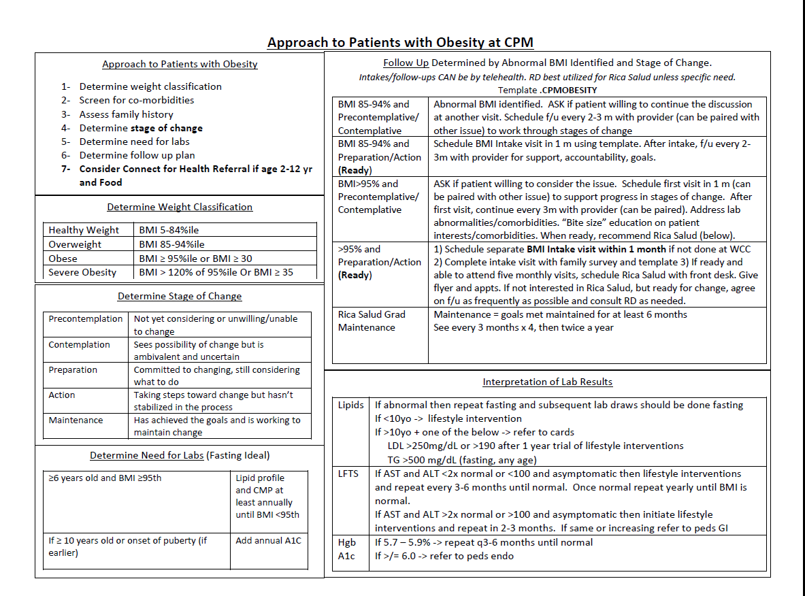

Slide 14
Follow Up
85-94% (overweight):
Not Ready: Follow w provider (may be part of another visit)
Ready: Follow w provider
>95% (obese):
Not Ready: Follow w provider (may be part of another visit)
*Ready: Intake Visit within 1 month w provider. AFTER the intake visit, we refer families to our Rica Salud/Rich Health program. *If no RD, consider agreeing on a certain number of scheduled follow ups q 4-6 weeks to work on goals w provider. Success is linked to frequency and quality of follow up.
Many insurances cover up to 6 provider and 6 RD visits per yr related to nutrition/exercise counseling for obesity and comorbidities.
Notes:
Use our resources as tips for guiding goals and pt education in the primary care setting

Slide 15
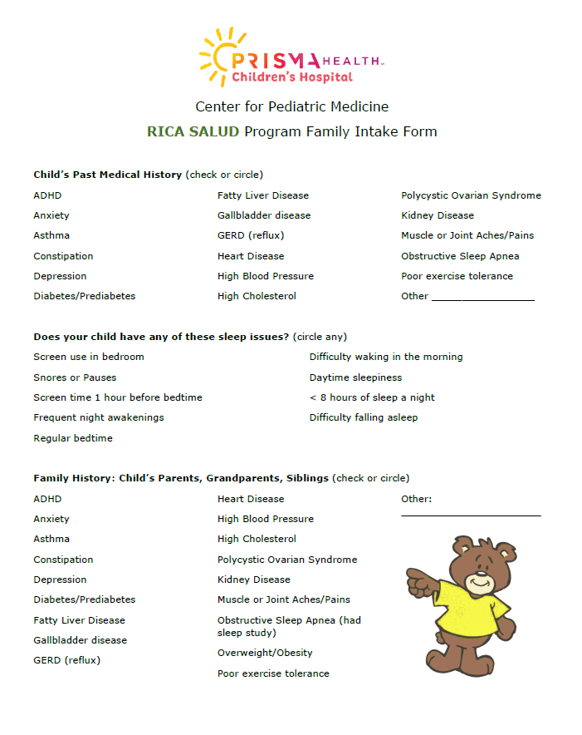
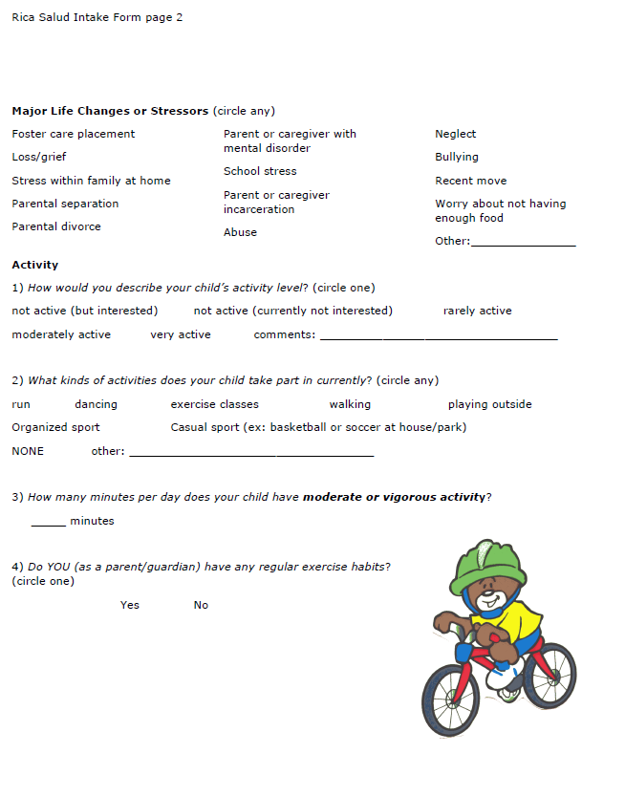
INTAKE VISIT: Family Form
Relevant PMH, FH
Sleep Issues
Stressors
Activity
+ Diet Hxin template
+Refer to their most recent WCC Social and Emotional Screeners
Notes:
SWYC (social and well being of young children) comprehensive screener

Slide 16
Social/Emotional Screeners on SWYC
Should be recent (within the year) and updated if needed
We underestimate the relationship between obesity and trauma (ACEs) and obesity and socio-economic conditions (SDH)
These issues are often beyond habits and emotional eating!
We should make no assumptions - every patient needs a comprehensive intake.
Notes:
With ACEs, developing brains and the neuroendocrine system are affected, altering patients epigenetics. Structural brain differences are found in the areas of the brain linked to appetite control. Increased stress raises cortisol release, increases insulin resistance, alters satiety. Food scarcity is associated with hoarding, overeating.

Slide 17
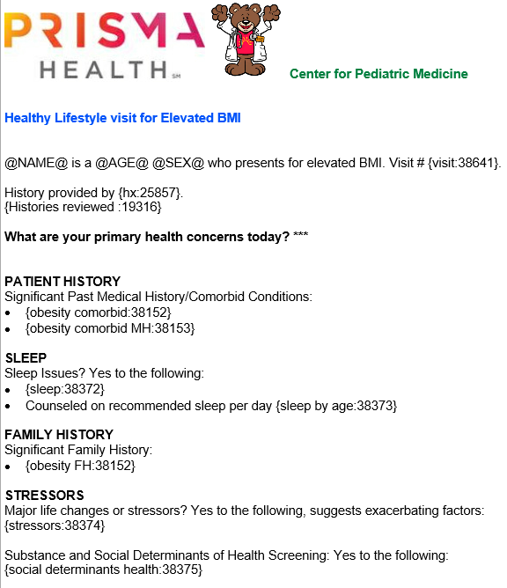
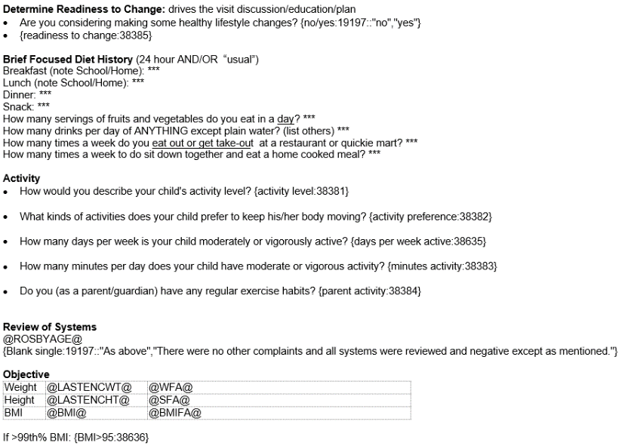
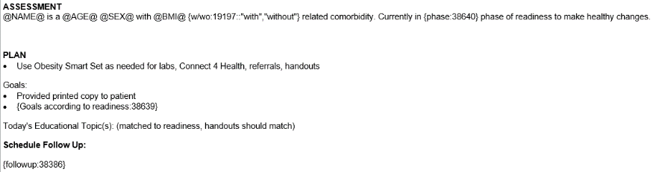
This Photo by Unknown Author is licensed under CC BY
Notes:
Our template has drop downs to remind a provider of the recommendations in different categories

Slide 18
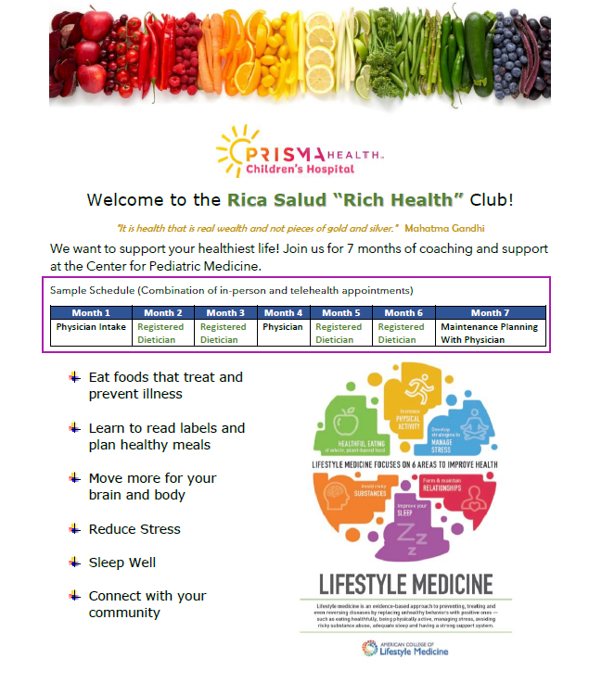
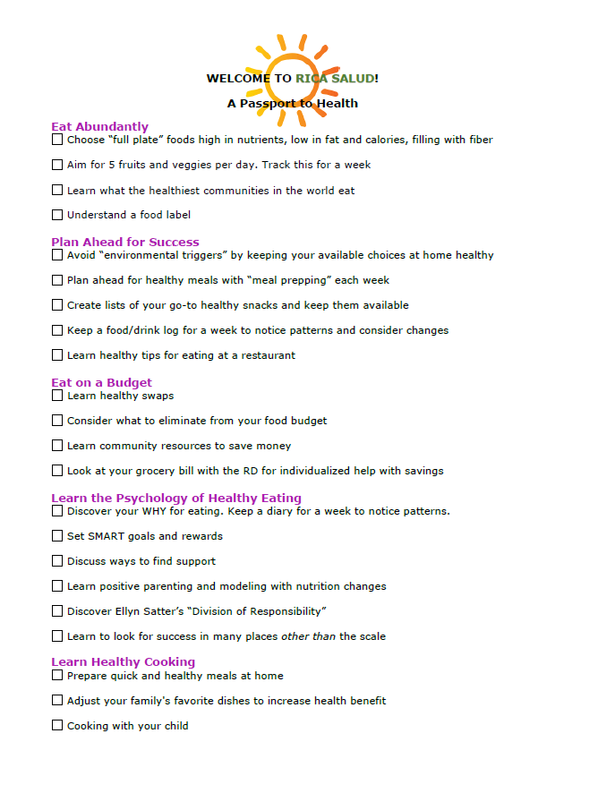
Notes:
I would advocate that every practice should have access to a dietician by telehealth or in person for referral for patients that are > 95% and ready for change. But many practice do not have a dietician to refer to. Most of the nutrition goals can be set by primary care providers or mid level providers if they have the right resources and handouts to guide them.

Slide 19
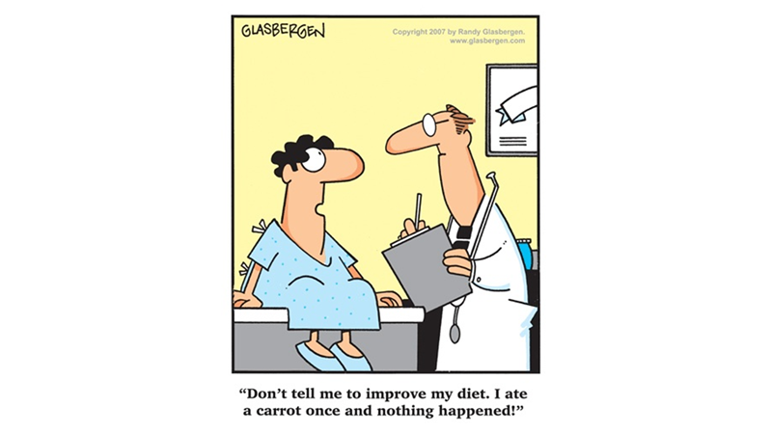
Part 1: Predictable Flow
Part 2: Stage of Change/MI
Part 3: LM Principles
Part 2: Stage of Change and Using MI
Notes:
Behavior Change can be difficult because it’s so personal, non-linear ,and long-term. Also, in pediatrics, it usually involves more than just the identified patient.

Slide 20
“What Motivates People?”
Notes:
At the core of BC theory is the question...

Slide 21


Self-Determination
People are generally better persuaded by the reasons which they have themselves discovered, than by those which have come into the minds of others
Blaise Pascal (1600s)
Notes:
The #1 theory of human behavioral change is SELF DETERMINATION. SD refers to each person's ability to make choices and manage their own life. This is at the foundation of motivational interviewing which is a patient-centered, coaching style that puts the patient in the driver seat as the expert on her own life.

Slide 22
What approach were most of us modeled and taught in medical training?

Slide 23

The Complete Opposite!
Didactic (information giving)
Directive (orders)
Expert Mentality
Practitioner-Centered
Notes:
While there is a time and place for this type of communication style: there is little evidence that style of teaching in the office impacts behavior change, but there is an abundance of evidence for MI for improving health outcomes and behaviors. A common misconception is that this is more efficient, where actually engaging the patient in the solution is almost always more efficient and even called a “corner cutter”.

Slide 24

RE-DEFINE OUR ROLE in supporting change
Adopt a “Coach” rather than “Expert” mentality
Acknowledge that the PATIENT/FAMILY is in the driver’s seat.
THEY are the expert in their own life.
RE-DEFINE SUCCESS in terms of behavioral change
Changing health behaviors can lead to significant improvements in long-term
in health and well being even with little to no change in body weight.

Slide 25
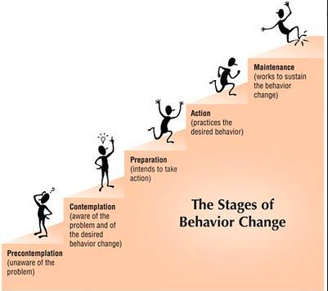

“Meet Patients Where They Are”
80% of patients will NOT be ready at first. Our job is helping them move through the early stages.
Motivational Interviewing
Notes:
No matter how high the BMI or how many comorbidities we recognize...when we give advice and a person isn’t ready, or give advice when we don’t know their situation, or worse when we criticize or shame…. all we do is drive folks away from the very place we hope to point them. The bottom line for us as providers is : We have to pay attention to what our patient is ready to do, not what we are ready to tell them to do . Through our algorithm, we emphasizethat readiness to change is at the core of your approach.

Slide 26
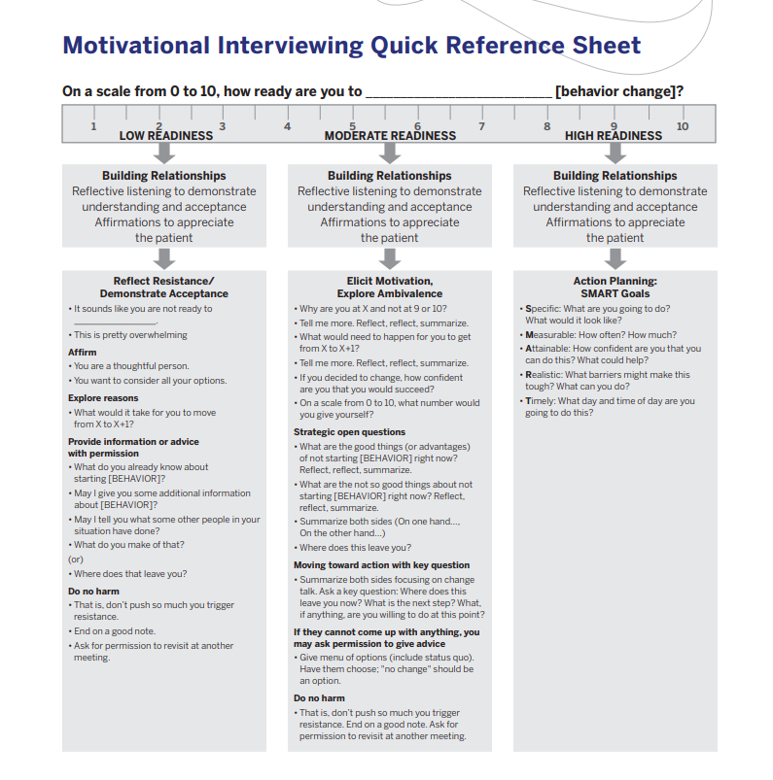
Building Relationships Reflective listening Affirmations
Notes:
As providers we need to RESIST THE RIGHTING REFLEX, our our reflex to do the work and fix things. We have to let the patients do this work if they are to own it. THIS SUPPORTS SELF DETERMINATION. When patients aren’t ready for goals, I’ll document a few lines about the patients thought process and reflections. Maybe about connections we briefly made between their elevated BMI and another health concern.Sometimes I’ll ask them to be curious or mindful about a habit and report back to me. I’m clear there are no goals or expectations, I just want to know their thoughts about it.

Slide 27


Motivational Interviewing: One of your best tools!
AAP Change Talk App: An excellent series of 3, 12 minute interactive case studies
Providers Clinical Support System (PCSS): Free 1 hour course 3/19/19
Healthysteps.org: 0-3, Motivational Interviewing, Great list of resources 4/12/2021
Motivational Interviewing for Overweight Children: A Systematic Review
“MI, compared to usual care, revealed positive effects for parent influence on young child anthropometric measures when applied. “ Pediatrics Volume 146, no 5, Nov 2020
Miller and Rollnick
Notes:
Keep Learning!

Slide 28
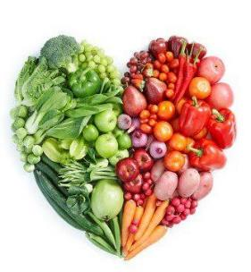
Ready for Change?
“TAF” GOALS
S- specific
M- measurable
A- attainable
R- realistic
T- time-based
Nutrition Example Screen Time Example
Type: vegetables screen time
Amount: increase to 2 per day (lunch, dinner) decrease to 2 hours per day
Frequency: 5 days of the week, school days 5 days per week, school days
Can the goals be attempted with positivity and collaboration?
Notes:
If the patient is truly leading, you should starting with ideas will be both attainable and relevant. Then TAF covers “specific, measurable and time-based”

Slide 29
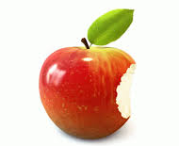
Ready for Change?
Offer Bite-Size In-Office Education
Resist lecturing
Be direct, neutral, state the facts and defer to EVIDENCE
“If you are interested in increasing physical activity, the AAP recommends...”
Notes:
Sometimes this type of office education can be like watering a house plant with a bucket
Defer to evidence (not your opinion) “According to the AAP..” or “The latest evidence…”

Slide 30

Ready for Change?
Give “At-Home Learning”
Decide Next Steps
At-home learning: pediatric lifestyle med resources (CPM google drive)
Referrals/community resources
Follow-up:
*Frequency and quality of interaction linked to success
*Follow up is an “opportunity to “check in and learn”
Notes:
Success is directly related to FREQUENCY and QUALITY of provider contact

Slide 31

NOT Ready? (refer to algorithm about follow up)
Think of resistance as a signal to change strategies.
Shift back to THEIR primary goals/concerns
Asthma? Plants decrease inflammation, PA
Constipation? Plants provide fiber and water
Mental Health/ACES? Sleep, managing stress, PA
ALWAYS leave on a positive note/affirmation
Ask permission to discuss at a future visit
⭐ Still get labs if indicated and document stage of change⭐

Slide 32
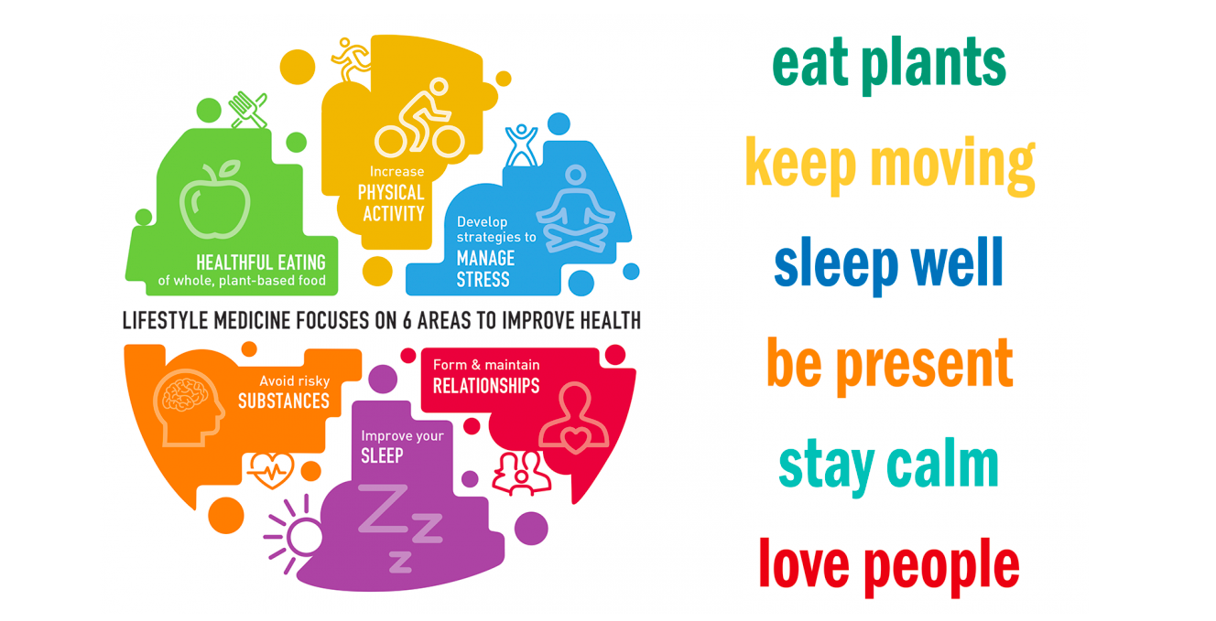
Part 1: Predictable Flow
Part 2: Stage of Change/MI
Part 3: LM Principles
Part 3: Lifestyle Medicine Principles
Notes:
I want to emphasize LM is NOT obesity medicine, but because obesity is a chronic disease, it fits perfectly into the model.

Slide 33
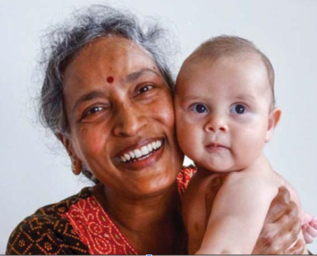
Health Poverty to Health Wealth
Nourishment Treat/Prevent disease
Abundance “Living Your Best Life” and
less tracking of portions/calories
Longevity
“Health is real wealth, not pieces of gold or silver.”

Slide 34

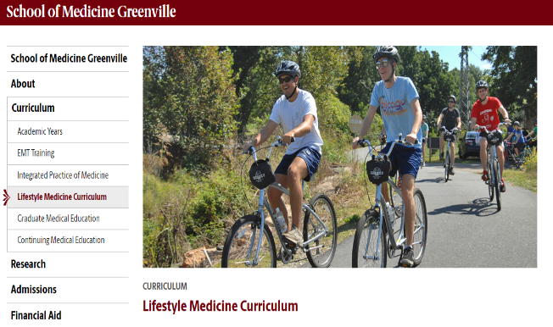
Lifestyle Medicine in Training
Fills Gaps for anyone wanting to learn and follow the evidence base in these 6 areas

Slide 35
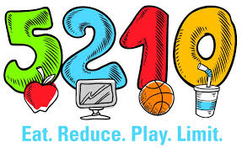


Lifestyle Medicine enhances our current efforts and community resources

Slide 36
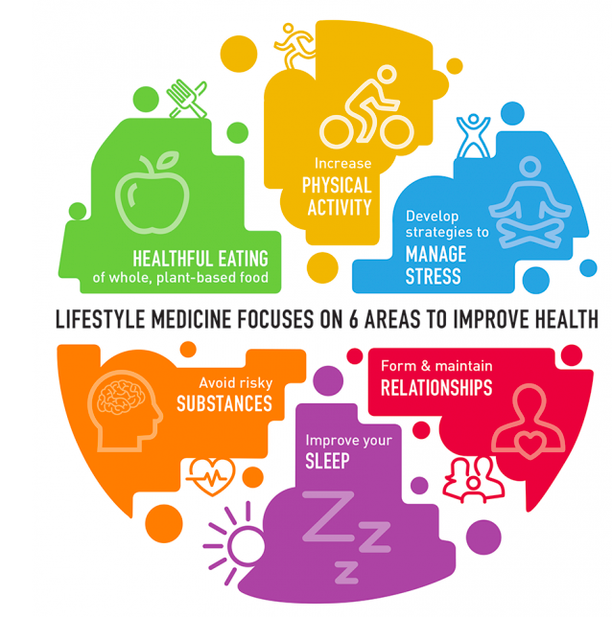
Lifestyle Medicine involves the use of evidence-based, therapeutic approaches to prevent, treat, and often reverse chronic disease by replacing unhealthy behaviors with positive ones.
Almost all clinical practice guidelines for the top chronic diseases support lifestyle as the first line of treatment.
Lifestyle Medicine addresses the ROOT CAUSES of chronic disease through these 6 pillars.
www.lifestylemedicine.org
Notes:
The ACLM Started in 2004, The ABLM offered it’s first board certification exam in 2017. It has been a GLOBAL collaboration from the beginning. Pediatric and Adolescent section growing by leaps and bounds.

Slide 37
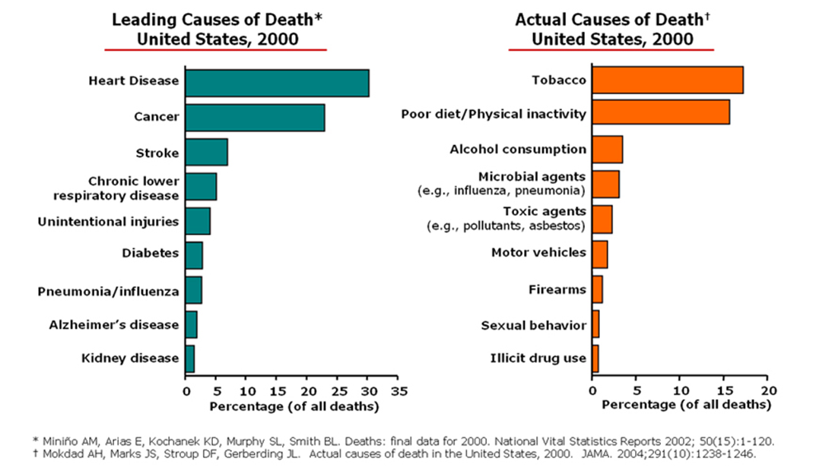
CDC: US Causes of Death in 2000
“Root causes”
Notes:
This is a graph from a 2000 CDC study with AGE ADJUSTED DATA comparing leading causes of death (on the LEFT) with actual causes of death (on the RIGHT). Actual Causes are also called “root causes” : (for example: if death by cancer was on a death certificate, but the root cause was actually tobacco use) Take a look at five OF the top leading causes of death on the left:

Slide 38
CDC: US Causes of Death in 2000
“Root causes”
50% of deaths were from just 3-4 preventable behaviors!!
Notes:
We know that the development of these diseases on the left occur over many decades, starting with root causes or lifestyle factors, most of which formed early in childhood, even starting in the womb. So early healthy habits are critical to preventing premature death.

Slide 39

Lifestyle Factors Account For:
80% of Heart Disease
1/3 of Cancers
9 out of 10 cases of Type 2 Diabetes

Slide 40
ROOT CAUSES OF Pediatric Obesity
Sleep: Poor quality and/or quantity
Physical Activity: Quantity, intensity, mobility issues, access. How much sedentary time and what that involves (if it’s screen time, targeted advertising)
Eating Behavior: Cultural eating patterns. Emotional feeding/eating. Food insecurity. Influences of targeted advertising, particularly to minorities.
Stress/Relationships: Stigma, bullying, stressors, body image, self esteem, anxiety, depression. Social determinants of health. ACEs.
< 1% caused by medications, endocrine, metabolic issues

Slide 41
Lifestyle factors account for 80% of disease and 50% of premature death.
The most impactful piece is moving away from the S.A.D (standard american diet) toward whole food, plant-based nutrition

Slide 42
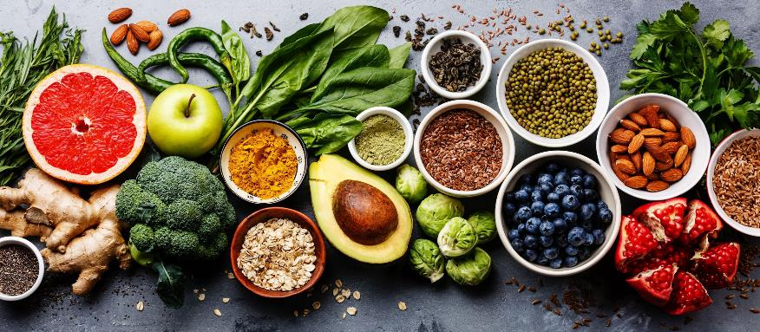
Whole Food Plant Based (WFPB) Nutrition
Maximizes Whole Foods
As found in nature or minimally processed
95% Plant-Based
Veggies, Fruits
Whole Grains
Legumes (beans, pulses)
Nuts, Seeds
Herbs, Spices
Notes:
95% Plant Based on a 2000 cal diet adds up to only 100 cals/d from animal products

Slide 43
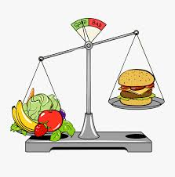
Whole Food Plant Based (WFPB) Nutrition
Minimizes
Highly processed foods and refined carbohydrates
Salt and sugar (small amts for flavor only)
Fats and oils
Meat - including poultry and fish
Dairy - milk, cheese, butter, yogurt, eggs
Only 5% calories from animal products = 2 oz < 5x/month

Slide 44
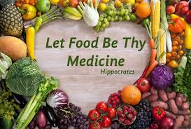
Health Benefits of WFPB Nutrition
People who are plant-based across the world have lower rates of obesity and related conditions like heart disease and diabetes. Lower rates of cancer. Lower rates of constipation, asthma/allergies/eczema, autoimmune diseases; decreased frequency of URIs, migraines, acne, and improved emotional well being
Notes:
There is an abundance of evidence for health benefits

Slide 45
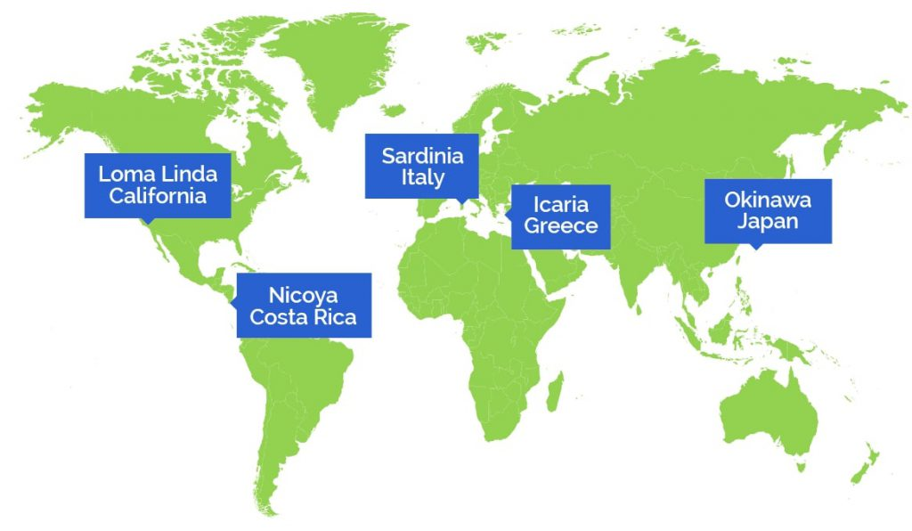
Where DO people live the longest, healthiest lives?
The Blue Zones
Notes:
Back in In 2004 researchers from National Geographic, the National Institute on Aging, and the world's best longevity researchers teamed up and they asked: where DO people live the longest healthiest lives…. and why?

Slide 46
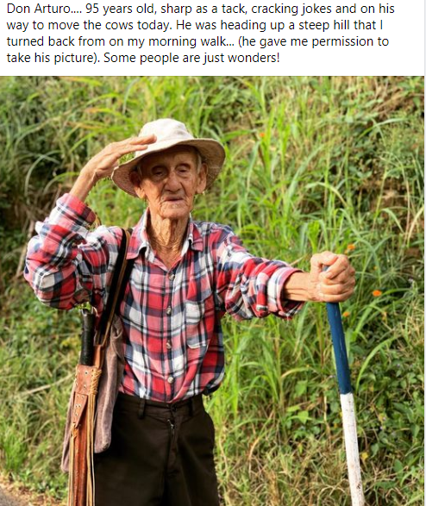
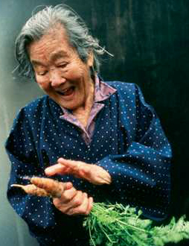
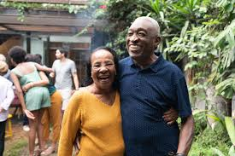

The “Blue Zones” are 5 areas, where people reach 100 yrs old at a rate that is 10x greater than in the US and with lower rates of chronic disease.
Notes:
The Nicoya Peninsula in CR is one of those areas and we have a friend who lives there and sent me this photo: the caption says “

Slide 47
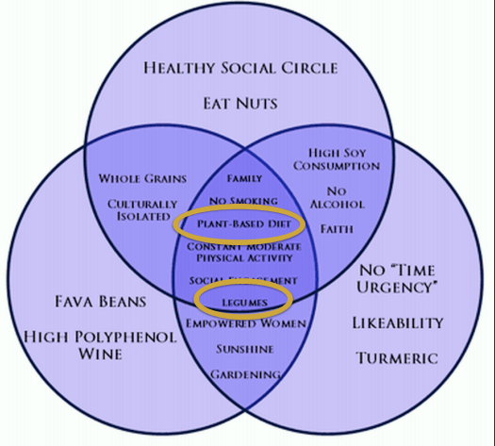
What do the Blue Zones have in common?
Only 5% calories from animal products = 2 oz < 5x/month
Notes:
The blue zone intersect in the dark purple area. I like to point out to my patients that the HEALTHIEST COMMUNITIES IN THE WORLD are NOT the wealthiest in terms of income. They eat the most plants (circled), are naturally active, they are socially connected and they don’t smoke. Everyone including children and elderly in these communities have a sense of purpose - there is no concept of retirement from work, the work just changes. These healthy pockets don’t have different DNA than those around them, they have different lifestyle habits.

Slide 48
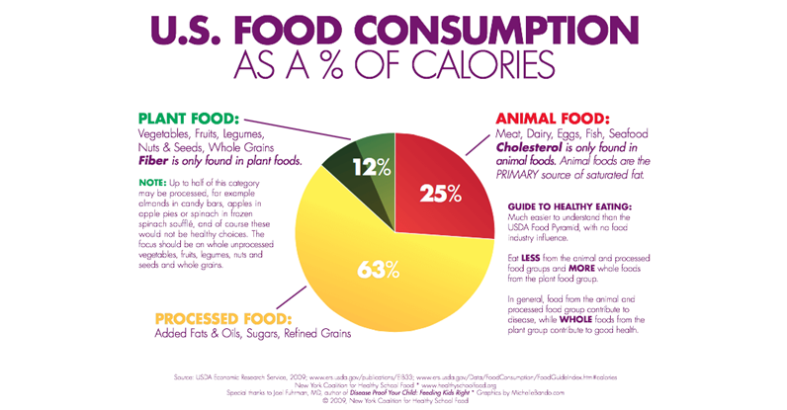
1/2 of this is highly processed!
< 3% of Americans get enough fiber
We eat 800 more calories per day than the rest of the world
Notes:
Almonds in candy bars and apples in apple pie included in ½ that plant wedge!!

Slide 49
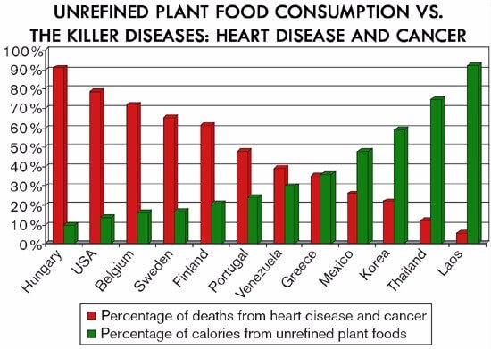
Notes:
Another in JAMA Intern Med 2016: “Association of animal and plant protein intake with all cause and cause-specific mortality.”

Slide 50
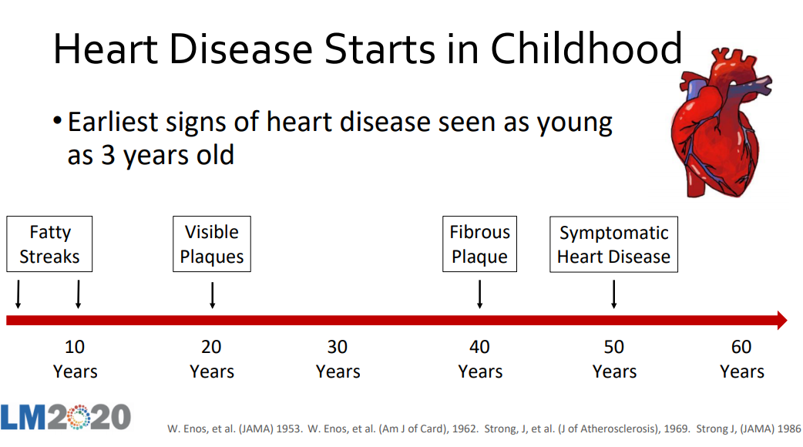
Notes:
By 10, nearly ALL children have fatty streaks. By 20, fatty streaks in the CORONARY ARTERIES. A 2018 study published in Nutrition Review found that a Plant Based diet in childhood decreases the risk of CV disease as an adult. This makes sense, because cholesterol ONLY comes from animal products and fiber (that flushes out cholesterol) is ONLY found in plants. In LM, we classify heart disease as a foodborne illness.

Slide 51
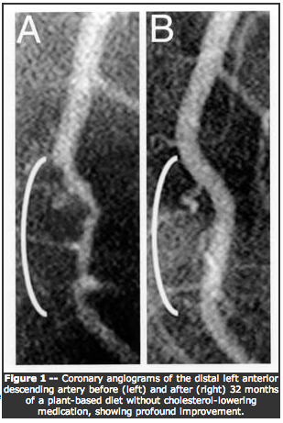
WFPB is the ONLY eating pattern shown to reverse heart disease
Ornish, Esselstyn –pioneers in LM
Benefits seen in just 3 months
Arteriograms before and after 32 months on a plant-based diet showing reversal of stenosis without lipid lowering medications
C. Esselstyn MD, Cleveland Clinic
Esselstyn CB Jr, Gendy G, Doyle J, Golubic M, Roizen MF. A way to reverse CAD? J Fam Pract. 2014 Jul;63(7):356-364b. PubMed PMID: 25198208.
Notes:
In July of 2014 he reported the experience of 198 participants seriously ill with cardiovascular disease. During 12 years of follow up of the 89% adherent to the program, 99.4% avoided further major cardiac events. Dean Ornish, MD, Caldwell Esselstyn Jr., MD, and others have shown that a low-fat, plant-based diet, combined with regular exercise and a healthy overall lifestyle, can prevent, delay, and even reverse heart disease and other cardiovascular events.Dr. Ornish’s landmark study tested the effects of a plant-based diet on participants with moderate to severe heart disease. There were no surgeries or stents—just simple diet and lifestyle changes. Within weeks, 90 percent of chest pain diminished. After just one month, blood flow to the heart improved. After a year, even severely blocked arteries had reopened. At the Cleveland Clinic, Dr. Esselstyn tested the same approach on patients with severe heart disease and published similar results. Thirty years later, all of the compliant patients are still thriving.

Slide 52
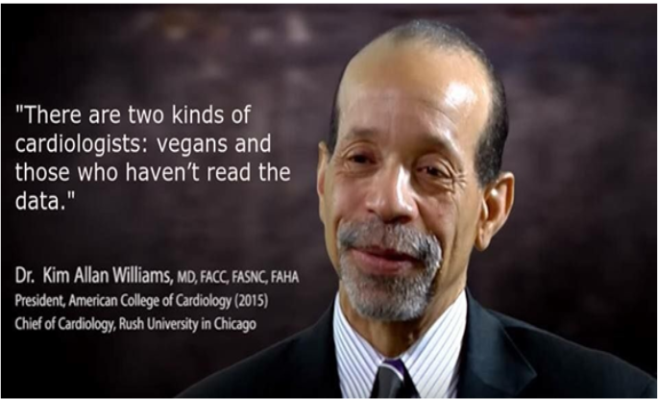

Slide 53



Cancer
Overweight/obesity increases your probability of developing 12 different types of cancer.
Dairy is linked to breast and prostate cancer b/c increase in IGF-1
Processed Meats: Group 1 Carcinogens (tobacco smoke, asbestos)
Red Meats: Group 2A Carcinogens “Probably carcinogenic to humans”
What girls consume during childhood turns out to be more important for their risk of breast cancer at age 60 than what they are eating the decade before their cancer diagnosis.
Notes:
A newborn cow grows to 1000# in ONE YEAR!!!

Slide 54
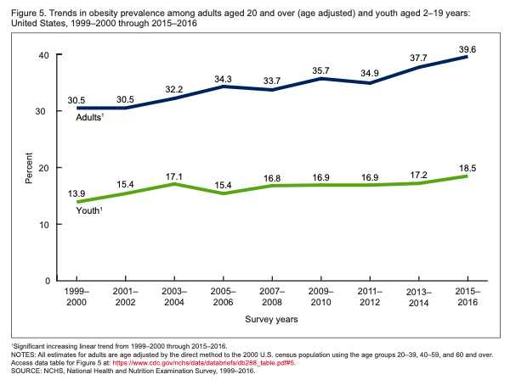
Obesity/Type 2 Diabetes
Poor Nutrition, Higher Rates of Chronic Disease
Obese children have a much higher risk of becoming an obese adult (50-80% depending on age)
1 in 3 children born in the year 2000 or after will receive a T2D diagnosis in their lifetime (for hispanic children, 1 in 2)
T2D can cut up to 20 yrs off your life expectancy!
Notes:
A low fat, plant based diet has been shown to be more effective than the standard ADA diet, greatly improving and even reversing diabetes. Landmark Study funded by NIH, published 2002 NEJM: Lifestyle changes were more effective than metformin in reducing the incidence of diabetes in persons at high risk for developing.

Slide 55
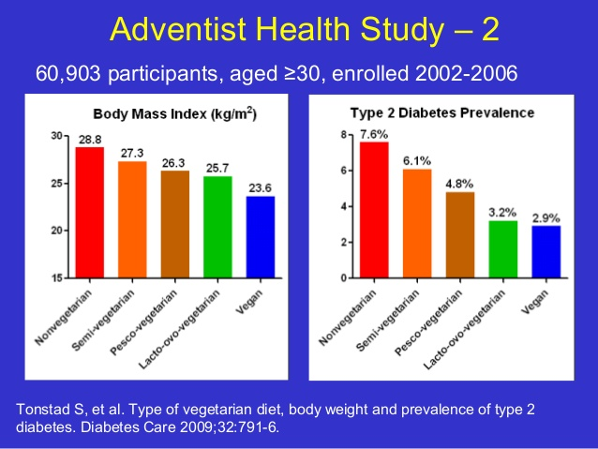

Slide 56
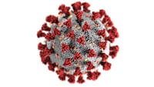
Covid -19
Recent study of 592,571 participants in UK and US linking healthy plant-based nutrition with lower risk of getting COVID-19 and lower risk of having severe disease after infection.
Nearly ⅓ of cases would have been prevented if one of 2 exposures were not present - poor diet or socioeconomic deprivation (SDH).
Recent study published in Gut, lead by researchers at Massachusetts General Hospital

Slide 57
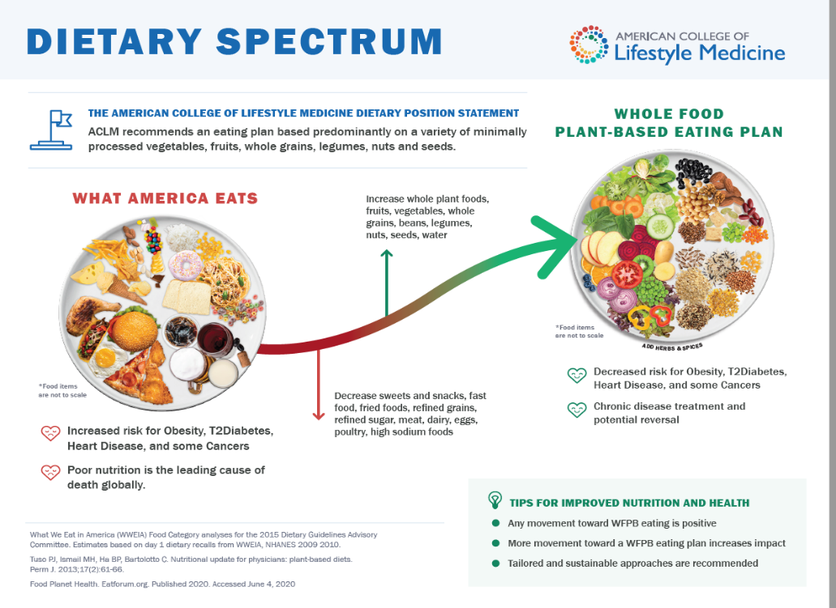
“WFPB”
“S.A.D.”
Notes:
You might be wondering how to promote this in a busy office, and I’m going to show you in the next group of slides. A BIG concept here is not perfection, it’s about looking for a SHIFT from left to right for better health and longevity. We should know that ANY movement toward WFPB eating is positive - it’s a dose response

Slide 58
A plant based nutrition is a spectrum
(plant-forward or plant-predominant)
S.A.D mediterranean versions of vegetarian 95% WFPB
Including more nutrient-dense whole plant foods →
Minimizing animal products and highly processed foods →
Improving health and longevity in a dose-response manner
Notes:
Terms can get confusing, but vegetarians include some animal products such as dairy, egg, fish. Vegans do not have any animal products. However a vegan diet CAN be very poorly planned including lots of highly processed foods (white bread, oreos, candy are all vegan)

Slide 59
Plant-Based Children vs Omnivores
Higher intake of
Fiber
All vitamins and minerals (except Ca)
Fruits and vegetables
Wider variety of whole foods
Recommended intake of
Calories and Protein (meet or exceed RDA for iron)
Lower intake of:
Total fat, saturated fat, cholesterol
Notes:
Compared to kids on SAD, PB children have lower rates of chronic disease as well as lower rates of acne, allergies, URIs, ear infections and digestive diseases. With a PBD there is also less exposure to environmental toxins and pollutants which accumulate as you go up the food chain.

Slide 60

Wide Endorsement
Academy of Nutrition and Dietetics: Well-planned vegetarian/vegan diets are appropriate for individuals during all stages of the life cycle, including pregnancy, lactation, infancy, childhood, adolescence, and for athletes. 2016
Notes:
The purpose of this national non profit is to transform food landscape in pursuit of health equity. You can see that LM works very well within our current national nutrition efforts

Slide 61
Core Concepts of WFPB Nutrition
Higher plant intake is anti-inflammatory (nutrient rich)
ONLY plants have fiber
ONLY animal products have cholesterol
Plants have healthier fats (excluding coconut and palm oil)
A plant-based diet ALONE decreases:
CAD by 40%
cerebral vascular disease by 29%
metabolic syndrome/T2D by 50%

Slide 62
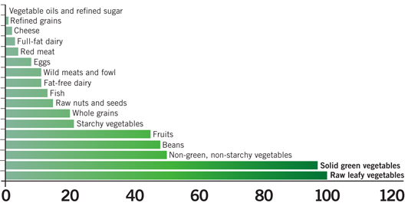
Core Concept: Nutrient Density per Calorie
Animal-based foods
Plant-based foods
Adapted from Eat to Live, Joel Fuhrman.

Slide 63
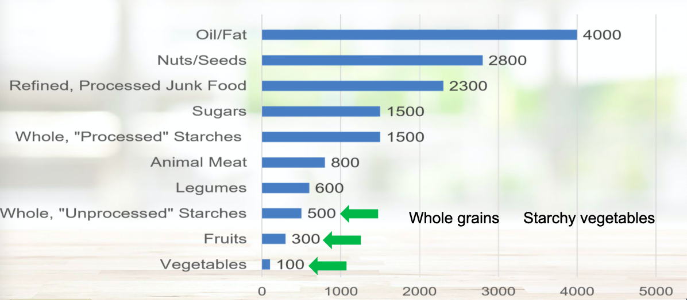
Core Concept: Calorie Density (cals/#)
1 Tbsp = 120 cals!
Credit: ACLM Webinar on Calorie Density

Slide 64
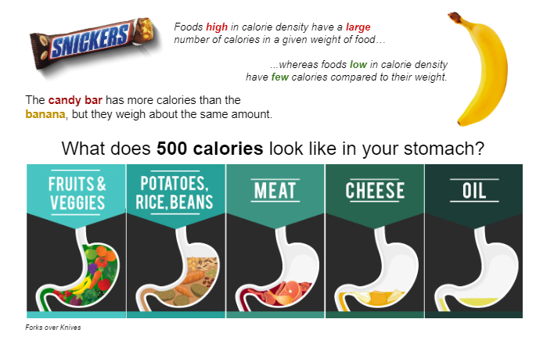
Core Concept: Calorie Density and Satiety
Notes:
Many weight loss efforts leave people feeling restricted and hungry. FIBER MAKES YOU FEEL FULLER, LONGER (plus it lowers cholesterol, improves many GI issues, and has lower calorie density per pound (which is why it’s helpful with weight loss).

Slide 65
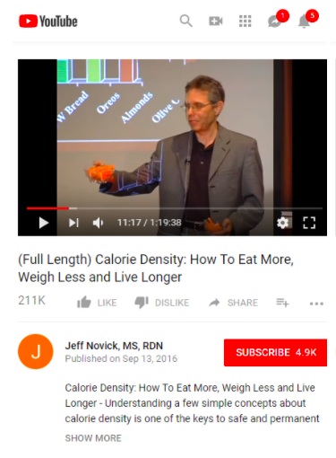
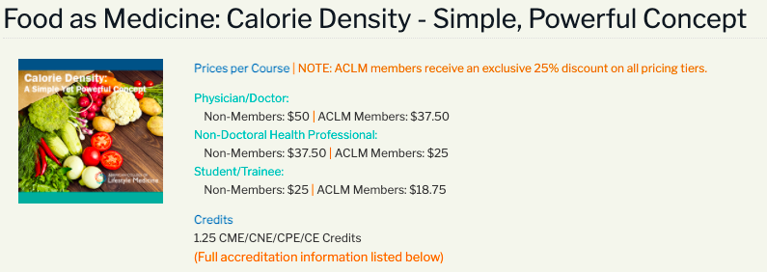
Calorie Density: 1 hour talks

Slide 66
Core Concept: Birth-3 years
Different Nutritional Needs Per Kg Compared with Adults
Twice as much Fat
50% more protein
3-4 x more calories
Higher Nutrient Density
This is WELL within what they can get from a PBD
+Breast milk, soy formula, or plant milk
AAP -soy formula is safe and appropriate for Full term babies

Slide 67

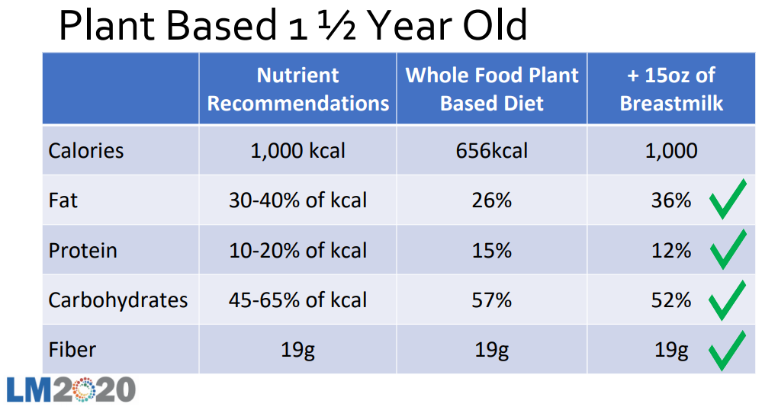

“Well Planned”
Dr Jackie Busse
Insta: @plantbasedpediatrician
Notes:
BECAUSE they have different nutritional needs, this term “well planned” used by the Academy of Nutrition and Dietetics is important.

Slide 68

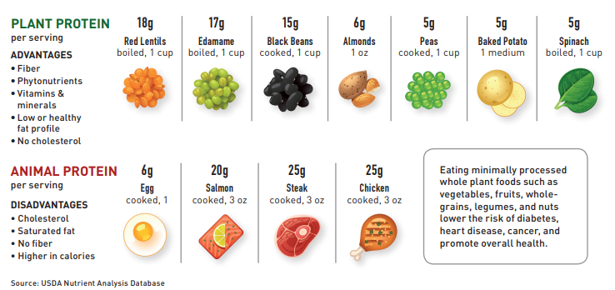
Will they get enough protein?
Notes:
Yes! Protein requirements are easily met on a PBD! All of these foods on the top row provide a fantastic source of protein without the fat and inflammation of meat. Essential AA are present in all plants.
A cup of barley has 23 g of protein!! (Oatmeal, Quinoa and spaghetti are all about 7 g per serving)

Slide 69

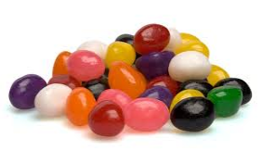
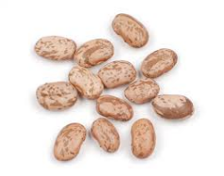
Should we avoid “Carbs”?
vs
Minimally processed complex carbohydrates are the perfect fuel with a slow, steady release of energy. Whole grains, legumes, fruits/veggies
Notes:
Slowly absorbed and digested

Slide 70
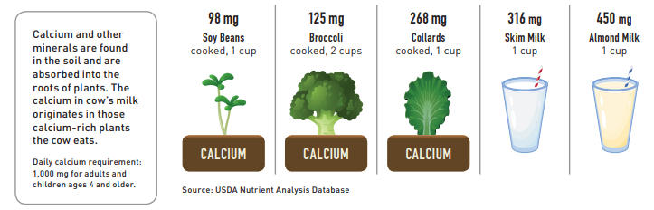
Will they get enough calcium?
Fortified, unsweet Soy, Oat, Pea Milk

Slide 71
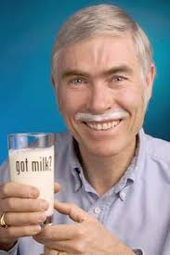
The Dairy Question
AAP RECOMMENDATIONS
0-1 yr NO cows milk
1-2 yr 2-3 cups of whole milk
2-5 yr 2-2.5 cups of skim or 1%
AAP: (Fortified, unsweet) Soy milk is nutritionally equivalent to cow’s milk and is an acceptable alternative.
!!Equivalent of 24 slices of bacon a week!!
Notes:
Based on CALORIES for GROWTH and FAT for Brain and Eye development. ¼ of an avacado or ½ Tbsp nut butter would make up the fat difference
WATER - around 6 m can have ½-1 cup /day , 1-2 yr old: 1-4 cups per day, 2-5 yr old up to 5

Slide 72
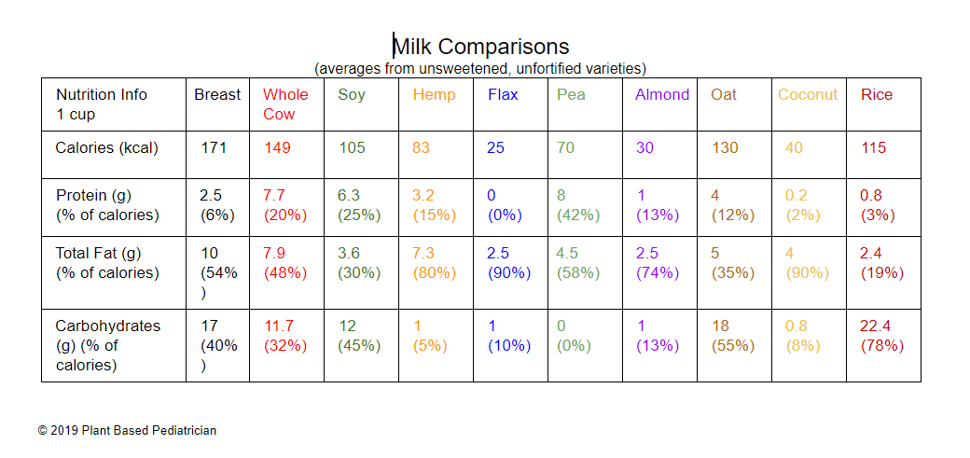

Slide 73
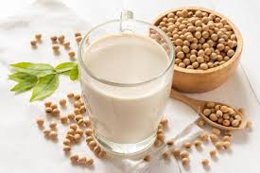
Is soy safe?
Whole Forms of Soy Are:
-High in nutrients
-Phytoestrogens “Isoflavones” are not the same as estrogen
-Growing evidence that whole forms of soy are protective against breast and prostate cancer
Whole forms of soy
Edamame
Tofu
Tempeh
Miso
Milk
Notes:
in human studies, the estrogen effects of soy seem to either have no effect at all, or to reduce breast cancer risk, possibly because the isoflavones can actually block the more potent natural estrogens in the blood. In a true milk allergy up to 50% an be allergic to soy as well

Slide 74
Is Dairy Safe?
Fun Fact: Canada dropped dairy entirely from their food pyramid
NEJM 2020 “Milk and Health”
The most common food allergen in children <5y
Lactose Intolerance 70-80% worldwide
Iron deficiency
Casein, IGF-1 associated with Breast and Prostate Cancer
May not be associated with bone health:
-Higher hip fracture rate in countries with higher dairy consumption
-Pediatrics 2005: 3 large meta-analyses describing that milk does not improve bone integrity in children or prevent stress fractures
Saturated fat and cholesterol in milk is associated with CAD
Comedogenic (Acne)
Notes:
Casein and IGF 1 associated with initiation, promotion and progression of ca growth. A baby cow needs to be 1000 # by 1 year old 17x it’s birth weight
For bone health the conversation needs to be more around: plant based sources of calcium like beans, greens and Ca fortified soy milk, adequate vitamin D, weight bearing exercise. In my practice, given this information, I’m just much more flexible in recommending soy formula or soy milk depending on the parent preference and the child’s needs.
Broccoli, Brussels sprouts, collards, kale, mustard greens, Swiss chard, and other greens are loaded with highly absorbable calcium and a host of other healthful nutrients. The exception is spinach, which contains a large amount of calcium but tends to hold onto it very tenaciously, so that you will absorb less of it. All kinds of Beans are loaded with calcium. There is more than 100 milligrams of calcium in a plate of baked beans

Slide 75



Summary WFPB Tips/Tools
Every time you eat/drink is a health opportunity
Start by eating more of plant foods you DO like
Try something new (frozen edamame below)
Substitute beans for meat (soup or tortilla)
Use less oil in food prep (120 cals per Tbsp!)
Find local sources of inexpensive fresh produce
Resources at the end of presentation to learn more about WFPB eating!
Notes:
Save money - use a re-usable water bottle and don’t buy drinks. Don’t buy highly processed foods. Use store brand, shelf stable, plant based staples. Supplement with fresh or frozen produce.

Slide 76

Notes:
Now onto my final objective which was to share with you my favorite LM resources related to reducing stress. I chose this topic because it’s been incredibly useful to me every day in the office and in personal life with friends and family and it also overlaps with all 5 other pillars.

Slide 77



SLEEP
Epic Template: Cues
# hours of sleep
based on age
Discuss light and melatonin suppression
Sleep loss creates hormone imbalance impacting hunger/satiety
Notes:
Sleep loss creates a hormone imbalance in the body that promotes overeating and weight gain. Leptin and ghrelin are hormones that regulate appetite, and when you aren't getting sufficient sleep, the production of these hormones is altered in a way that creates increased feelings of hunger

Slide 78



Physical Activity
Improves Physical Health and Longevity regardless of BMI
Talk about PA in terms of weight maintenance (not weight loss)
Physical activity is called “The most underutilized antidepressant”
“What is enjoyable, accessible, and practical?”
Children: 1 hour/day + wt bearing activity
16yr-adults: 150 mins of moderate PA per wk
Notes:
If you remember the blue zones, they just move naturally in their daily life, walking more and sitting less --- all of it is beneficial.

Slide 79




Slide 80



Developing and Maintaining Relationships
In many studies, social connection is the single most important predictor of happiness, health, and longevity!!
Even brief, authentic connection activates the PNS to lower stress
“How are you connecting with friends and family these days?”
Notes:
The key note address at the ACLM national conference focused on this pillar

Slide 81




Managing Stress
Notes:
chronic stress, or poorly managed stress, may lead to elevated cortisol levels that stimulate your appetite

Slide 82



Calm Kit Items
Creating a “Calm Corner” or “Calm Moment”
A = Awareness (time for a break)
B = Breathing (teaching how to calm PNS)
C = Calming (bubbles, “lovie”, music, journal, draw)
Calm Corner: Credit to Michelle Dalal, MD (ACLM)

Slide 83




Mental Health Resources
Specifically for Teens

Slide 84





Free Mindfulness, Stress Reduction Apps
AAP reccomended
Free Provider Course
https://drjud.com/health-care-provider-course/
Not Free but Excellent:
Headspace and Fit Mind
Bambú (spanish)

Slide 85



What We Find Helpful
OFFICE FLOW is needed and appreciated for consistency
STAGES OF CHANGE/MI Let your visit and your plan reflect that you are meeting patients “where they are”. This is more effective and more satisfying for both provider and patient.
LIFESTYLE MEDICINE Obesity care is optimized with a comprehensive approach to the patient in their environment. LM has great resources to fill our educational gaps! Emphasize a well-balanced WFPB diet - it’s not only SAFE for children and effective for weight management, but it gives them the best foundation for lifelong health.

Slide 86

“Good Habits Formed At Youth Make All the Difference.”
Aristotle

Slide 87


Slide 88
WFPB Resources
Social Media:
Dr Yami Cazorla-Lancaster “Veggie Doctor Radio”
Plant Based Pediatrician (Dr Jackie Busse)
Nutrition Facts.org (Dr Michael Greger)
Plant Based Juniors
Food is Medicine Greenville (Dr Beth Motley)
Websites
Veggie Fit Kids
Physician Committee for Responsible Medicine
T. Colin Campbell Center for Nutritional Studies
Jeff Novick
Movies:
Forks Over Knives
Game Changers
What the Health
Cowspiracy
Recipes: Sites and Cookbooks
Minimalist Baker
Forks over Knives
Flava My Plate Cookbook
Oh She Glows
John McDougall’s recipes
Engine 2 Diet
How Not to Die Cookbook
Happy Herbivore
Straight up Food
By Any Greens Necessary
WFPB Cooking Classes:
E. Cornell plant based cooking PCRM, forks over knives, rouxbe.org

Slide 89






Books

