Slide 1
Spring QI Workshop A Lifestyle Medicine Approach to Pediatric Obesity in the Medical Home April 21, 2022
WHAT IS LIFESTYLE MEDICINE: Lifestyle Medicine uses evidence-based lifestyle therapeutic intervention – including a whole-food plant predominant eating pattern, regular physical activity, restorative sleep, stress management, avoidance of risky substances, and positive social connection – to prevent, treat and often reverse chronic disease. Lifestyle Medicine emphasizes positive psychology and motivational interviewing to support behavior change.

Slide 2
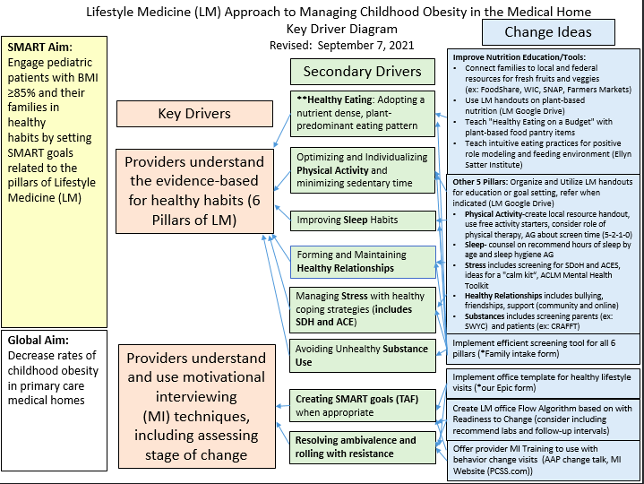
Quality Improvement Ideas

Slide 3
Quality Improvement( change) Ideas
Summary of past QI projects
Documenting appropriate BMI Z codes
Motivational interviewing; assessing patient readiness
Documenting SMART goals if appropriate
Focus on follow-up with MD and referrals to Dietician
All well visits between age 5-15, BMI will be assessed, recorded, and discussed
Expedite referrals to nutritionist; implemented a cooking class
Identify community resources (researched local groceries and food banks) implement informational sheets for patients)
Implementing a Lifestyle medicine based clinical pathway to address Obesity
Reminders in EMR about appropriate labs to be done
Changing language from “Obesity follow-up: to “Health Weight” or “Healthy Habits” follow-up

Slide 4
QI ideas for continuing Practices
Workflow changes to do appropriate labs based on BMI
Addressing some SDOH factors associated with Obesity
Partnering with local community resources , health department etc.
Working on improving compliance with follow up visits
Lifestyle medicine clinical pathway – practice spread
Continue Resident training on Motivational interview, lifestyle medicine approach

Slide 5
ABP MOC Part 4
To be Eligible for Part 4 credits:
Review the driver diagram and pick a measure
change idea that you want to work on
Write your Aim statement
define the denominator, numerator, percentage improvement and time frame
Collect 3 or more data sets and 2 QI Cycles
Do 2 PDSA or QI Techniques during the 9-week period (April 21st - June 15th)
QTIP practices can use QIDA data
Complete and send the ABP attestation form.

